Slide 1

wind and Solar Practicum
File created on: 2/25/2021 9:16:04 PM
Elisabeth Wolfert
elisabeth11kw@yahoo.com

Slide 2

Introduction Renewable Energy
I became interested in renewable energy and recycling years ago. While talking to my son at 32, he told me that he did not want to bring kids into the world because of global warming. This fact affects the younger generation that we have not taken care of our planet that God created for us.
We now see the effects of global warming due to extreme weather events. There are forces out there that are against renewable energy because they are afraid of change. Fossil fuel will run out one day, and this increases the importance of moving to renewable energy. It is a great time to change to renewable energy for the future of our children and our planet. Renewable Energy | California Energy Commission

Slide 3
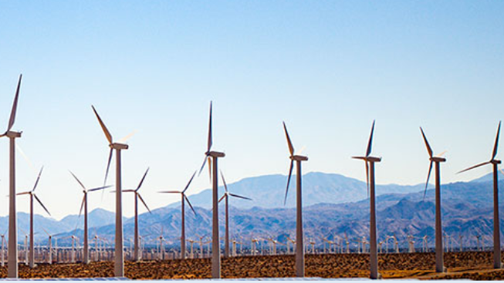
What are the benefits of windmill energy?
Windmill electricity does not pollute water or air, with the resulting energy from windmills does not increase global warming. Also, wind power does not deplete natural resources.
Another advantage to wind energy is that the use helps farmers who suffer from the high demands of farming based on weather conditions and drought. Farmers receive money from windmills on the farm and can still farm around the windmill.
In Europe, there are offshore wind farms that increase energy creation. Another benefit is the reduction in dependence on foreign countries for our power needs.
Windmill power can help rural areas with power needs, and now windmills come in a variety of windmill sizes. The current technology in wind power is becoming cheaper to produce as well.
Facebook uses AI to create models to store renewable energy in other forms that are cheaper to store. The electrocatalyst is a way to convert renewable energy to hydrogen or ethanol. Many different combinations of catalysts for use in the AI model to calculate the different combinations speeds up research.

Slide 4

Advantages of Solar Energy -There are many advantages to Solar energy, and many homeowners are adding Solar to their homes.
While researching the renewable energy movement driven by global warming and severe weather events. The public demand for solar energy has risen and with technology improving over recent decades. The sun provides a powerful energy source, and presently we can harness a small amount to eliminate the need for energy from your local power company. The Benefits of Solar Energy to the Environment are the reduction of greenhouse gases from fossil fuels. Fossil fuels produce gasses that harm the environment. Also, fossil fuel energy is finite and will run out one day, it is better to convert to renewable energy now before that occurs.
The use of solar panels saves money because you will not need to buy electricity from the power plant. If your solar system is connected to the grid, the surplus energy is sent back to your local power company and they may pay you for sell backs. Also, solar energy uses sunlight to produce electricity so you will not have to worry about running out of sun fuel for your electricity needs. Solar panels are low maintenance keep the solar panels free of debris and have them cleaned a couple of times a year.
With severe weather events have been an issue in recent years solar panels will help with grid security. Solar panels help with managing the load when the demand increases dramatically. In California, there have been rolling blackouts due to severe heat. These events were not as extreme as the weather event in Texas but based on the amount of renewable energy in California the event only lasted for a couple of days.
Renewable energy has increased the demand for a new type of jobs, these jobs involve installing the system, cleaning, and maintenance. Solar energy has many uses other than generating electricity or heat. It can be used to power satellites or even your RV when on the road. Energy demand increases during the day, and solar energy also increases during the day to maintain demand. Solar systems can be installed anywhere you need power, on the top of your house on land or ever on the top of your van or RV. Solar power can be directed to batteries to save energy when solar panels do not produce electricity.

Slide 5
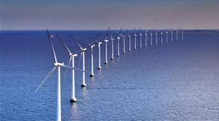
California Commitment to Renewable Energy
California is the highest populated state in the nation with 39 million residents. This creates a large demand on energy but due to the mild climate, California is 4th in the United States based on energy demand.
California had committed in 2006 through the Global Warming Solutions act of 2006 to set the goal for 33 percent renewable energy consumption by 2030.
In 2015 this amount was increased to 50 percent by 2030 which was met by 2020, the goal is 60 percent by 2030 and 100 percent by 2045. In this research, I will view the growth of renewable energy in California.
Watch this interesting video on California’s renewable energy movement progress.
Video on Solar energy in California: https://www.bing.com/videos/search?q=california+renewable+energy&docid=608050490897858695&mid=426950A0F8A356DB743B426950A0F8A356DB743B&view=detail&FORM=VIRE

Slide 6
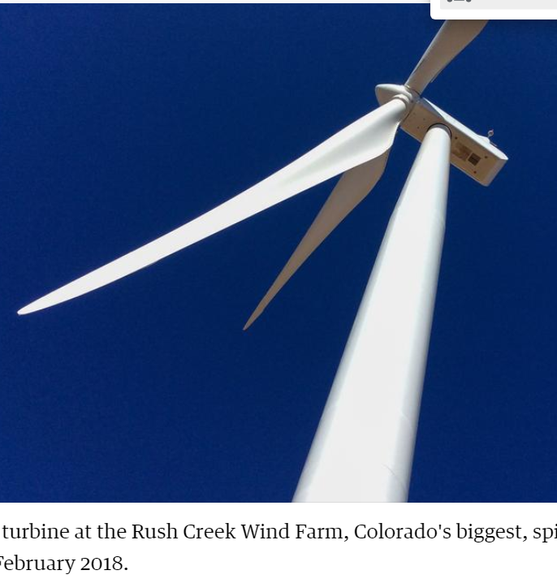
Colorado Commitment to Renewable energy
In 2004 Colorado passed a renewable energy initiative use 30 percent of its investor-owned energy companies and 20 percent of cooperative companies to use sources for energy from renewable energy sources by 2020. Colorado has 4000 jobs in renewable energy from 380 solar companies. Colorado is ranked eighth in the nation for solar energy as of 2014 produces 398MW of power. I will see if Colorado has improved in rank and solar production.
The use of wind power energy in the Denver area will benefit the community. I received an email from the local power company in the Denver area asking people to sign up to pay $1.50 a month to power my home with wind power. I added the use of wind energy for my power needs for nine dollars a month. The use of renewable energy makes me feel like I am doing a small part to help the environment and my community.

Slide 7
Practicum Project Solar and Wind Energy
Prediction Growth of Wind and Solar energy production
Has wind and solar energy production increased in the past 10 years? What can we expect the production to look like in the future? What is the rate of growth by state and which states growth rates are faster?
Climate change is a problem and utilizing wind and solar energy can reduce emissions and provide a clean energy source. What is the overall opinion of wind and solar energy based on comments from twitter?
Data Science tasks
Find growth areas for renewable energy.
Find areas where there is potential for renewable energy.
Find opinions on expanding renewable energy.
Analyze were based on population the greatest benefits for new renewable energy.

Slide 8
Data Source and Data Cleaning
Data
The current data source that I have is more than 33k records containing data from 50 states and 2 territories with data from 2011 to 2019. The data contains summary data with 87 different columns which I will summarize or remove columns if they do not add value.
Concerns – Finding accurate data sources for wind and solar energy. Understanding the data correctly to provide accurate results.
The data source for this project was in a cross-tab format. I loaded the data to a Postgres table on my Postgress database. I found after working with the data the format needed to be changed. I created a new data set including Month, Year, Date(Month||/1/||year), Type including: Solar or Wind, Com Type: including source use of energy: Residential, Commercial or Industrial.
Attached at the end of this document is an excel file containing a data dictionary and grouping of data fields.

Slide 9
Column Name | Description | dataStatus | Table Column Name | Data Type | Data Type Detail Group | Data Type Renewable
Year | Year | Year | Year | Number
Month | Month | Month | Month | Number
 |  | Month'/1/Year | Date | Date | First day of the Month in date format
State | State | State | State | Plain Text
utilityNumber | Utility Company Number | utilityNumber | utilityNumber | Number
utilityName | Utility Company Source | utilityName | utilityName | Plain Text
dataStatus | Type of Energy | dataStatus | dataStatus | Plain Text
type | Alternate or Direct Current | type | type | Plain Text
residentialCapacityPhotovoltaic | Residential Capacity for Photovoltiac | residentialCapacityPhotovoltaic | res_cap_photo | Number | Residential | Photo
commercialCapacityPhotovoltaic | Commercial Capacity for Photovoltiac | commercialCapacityPhotovoltaic | com_cap_phot | Number | Commercial | Photo
industrialCapacityPhotovoltaic | Industrial Capacity for Photovoltiac | industrialCapacityPhotovoltaic | ind_cap_photo | Number | Industrial | Photo
transportationCapacityPhotovoltaic | Transportation Capacity for Photovoltiac | transportationCapacityPhotovoltaic | trans_cap_photo | Number | Transportation | Photo
totalCapacityPhotovoltaic | Total Capacity for Photovoltiac | totalCapacityPhotovoltaic | total_cap_photo | Number | Total | Photo

Slide 10
Column Name | Description | dataStatus | Table Column Name | Data Type | Data Type Detail Group | Data Type Renewable
residentialCustomerPhotovoltaic | Residential Customer for Photovoltiac | residentialCustomerPhotovoltaic | res_cust_photo | Number | Residential | Photo
commercialCustomerPhotovoltaic | Commercial Customer for Photovoltiac | commercialCustomerPhotovoltaic | com_cust_photo | Number | Commercial | Photo
industrialCustomerPhotovoltaic | Industrial Customer for Photovoltiac | industrialCustomerPhotovoltaic | ind_cust_photo | Number | Industrial | Photo
transportationCustomerPhotovoltaic | Transportation Customer for Photovoltiac | transportationCustomerPhotovoltaic | trans_cust_photo | Number | Transportation | Photo
totalCustomerPhotovoltaic | Total Customer for Photovoltiac | totalCustomerPhotovoltaic | total_cust_photo | Number | Total | Photo
residentialStorageCapacityPhotovoltaic | Photovoltaic storage capacity for the residential sector reported in MW | residentialStorageCapacityPhotovoltaic | res_stor_cap_photo | Number | Residential | Photo
commercialStorageCapacityPhotovoltaic | Photovoltaic storage capacity for the commercial sector reported in MW | commercialStorageCapacityPhotovoltaic | com_stor_cap_photo | Number | Commercial | Photo
industrialStorageCapacityPhotovoltaic | Photovoltaic storage capacity for the industrial sector reported in MW | industrialStorageCapacityPhotovoltaic | ind_stor_cap_photo | Number | Industrial | Photo
transportationStorageCapacityPhotovoltaic | Photovoltaic storage capacity for the transportation sector reported in MW | transportationStorageCapacityPhotovoltaic | trans_stor_cap_phot | Number | Transportation | Photo
totalStorageCapacityPhotovoltaic | Photovoltaic storage capacity for all sectors reported in MW | totalStorageCapacityPhotovoltaic | total_stor_cap_photo | Number | Total | Photo
residentialStorageCustomerPhotovoltaic | Count of residential customers with storage for photovoltaic energy by utility name | residentialStorageCustomerPhotovoltaic | res_stor_cust_photo | Number | Residential | Photo
commercialStorageCustomerPhotovoltaic | Count of commercial customers with storage for photovoltaic energy by utility name | commercialStorageCustomerPhotovoltaic | com_stor_cust_photo | Number | Commercial | Photo
industrialStorageCustomerPhotovoltaic | Count of industrial customers with storage for photovoltaic energy by utility name | industrialStorageCustomerPhotovoltaic | ind_stor_cust_photo | Number | Industrial | Photo
transportationStorageCustomerPhotovoltaic | Count of transportation customers with storage for photovoltaic energy by utility name | transportationStorageCustomerPhotovoltaic | trans_stor_cust_photo | Number | Transportation | Photo
totalStorageCustomerPhotovoltaic | Count of all customers with storage for photovoltaic energy by utility name | totalStorageCustomerPhotovoltaic | tot_stor_cust_photo | Number | Total | Photo
residentialVirtualCapacityPhotovoltaic | Photovoltaic virtual capacity for the residential sector reported in MW | residentialVirtualCapacityPhotovoltaic | res_vir_cap_photo | Number | Residential | Photo
commercialVirtualCapacityPhotovoltaic | Photovoltaic virtual capacity for the commercial sector reported in MW | commercialVirtualCapacityPhotovoltaic | com_vir_cap_photo | Number | Commercial | Photo
industrialVirtualCapacityPhotovoltaic | Photovoltaic virtual capacity for the industrial sector reported in MW | industrialVirtualCapacityPhotovoltaic | ind_vir_cap_photo | Number | Industrial | Photo
transportationVirtualCapacityPhotovoltaic | transportationVirtualCapacityPhotovoltaic | transportationVirtualCapacityPhotovoltaic | tran_vir_cap_photo | Number | Transportation | Photo
totalVirtualCapacityPhotovoltaic | Photovoltaic virtual capacity for all sectors reported in MW | totalVirtualCapacityPhotovoltaic | total_vir_cap_photo | Number | Total | Photo
residentialVirtualCustomerPhotovoltaic | Count of residential virtual customers for photovoltaic energy by utility name | residentialVirtualCustomerPhotovoltaic | res_vir_cust_photo | Number | Residential | Photo
commercialVirtualCustomerPhotovoltaic | Count of commercial virtual customers for photovoltaic energy by utility name | commercialVirtualCustomerPhotovoltaic | com_vir_cust_photo | Number | Commercial | Photo
industrialVirtualCustomerPhotovoltaic | Count of industrial virtual customers for photovoltaic energy by utility name | industrialVirtualCustomerPhotovoltaic | ind_vir_cust_photo | Number | Industrial | Photo
transportationVirtualCustomerPhotovoltaic | Count of transportation virtual customers for photovoltaic energy by utility name | transportationVirtualCustomerPhotovoltaic | tran_vir_cust_photo | Number | Transportation | Photo
totalVirtualCustomerPhotovoltaic | Count of all virtual customers for photovoltaic energy by utility name | totalVirtualCustomerPhotovoltaic | total_vir_cust_photo | Number | Total | Virtual-Customer

Slide 11
Column Name | Description | dataStatus | Table Column Name | Data Type | Data Type Detail Group | Data Type Renewable
residentialCapacityWind | Residential Capacity for Photovoltiac | residentialCapacityWind | res_cap_wind | Number | Residential | Wind
commercialCapacityWind | Commercial Capacity for Photovoltiac | commercialCapacityWind | com_cap_wind | Number | Commercial | Wind
industrialCapacityWind | Industrial Capacity for Photovoltiac | industrialCapacityWind | ind_cap_wind | Number | Industrial | Wind
transportationCapacityWind | Transportation Capacity for Photovoltiac | transportationCapacityWind | tran_cap_wind | Number | Transportation | Wind
totalCapacityWind | Total Capacity for Photovoltiac | totalCapacityWind | total_cap_wind | Number | Total | Wind
residentialCustomerWind | Residential Customer for Photovoltiac | residentialCustomerWind | res_cust_wind | Number | Residential | Wind
commercialCustomerWind | Commercial Customer for Photovoltiac | commercialCustomerWind | com_cust_wind | Number | Commercial | Wind
industrialCustomerWind | Industrial Customer for Photovoltiac | industrialCustomerWind | ind_cust_wind | Number | Industrial | Wind
transportationCustomerWind | Transportation Customer for Photovoltiac | transportationCustomerWind | tran_cust_wind | Number | Transportation | Wind
totalCustomerWind | Total Customer for Wind | totalCustomerWind | total_cust_wind | Number | Total | Wind
residentialSoldBackWind | Residential Soldback for Wind | residentialSoldBackWind | res_soldback_wind | Number | Soldback-Residential | Wind
commercialSoldBackWind | Commercial Soldback for Wind | commercialSoldBackWind | com_soldback_wind | Number | Soldback-Commercial | Wind
industrialSoldBackWind | Industrial Soldback for Wind | industrialSoldBackWind | ind_soldback_wind | Number | Soldback-Industrial | Wind
transportationSoldBackWind | Transportation Soldback for Wind | transportationSoldBackWind | tran_soldback_wind | Number | Soldback-Transportation | Wind
totalSoldBackWind | Total Soldback for Wind | totalSoldBackWind | total_soldback_wind | Number | Soldback-Total | Wind

Slide 12
Column Name | Description | dataStatus | Table Column Name | Data Type | Data Type Detail Group | Data Type Renewable
residentialCapacityOther | Residential Capacity for Wind | residentialCapacityOther | res_cap_other | Number | Residential | Other
commercialCapacityOther | Commercial Capacity for Wind | commercialCapacityOther | com_cap_other | Number | Commercial | Other
industrialCapacityOther | Industrial Capacity for Wind | industrialCapacityOther | ind_cap_other | Number | Industrial | Other
transportationCapacityOther | Transportation Capacity for Wind | transportationCapacityOther | tran_cap_other | Number | Transportation | Other
totalCapacityOther | Total Capacity for Wind | totalCapacityOther | total_cap_other | Number | Total | Other
residentialCustomerOther | Residential Customer for Wind | residentialCustomerOther | res_cust_other | Number | Residential | Other
commercialCustomerOther | Commercial Customer for Wind | commercialCustomerOther | com_cust_other | Number | Commercial | Other
industrialCustomerOther | Industrial Customer for Wind | industrialCustomerOther | ind_cust_other | Number | Industrial | Other
transportationCustomerOther | Transportation Customer for Wind | transportationCustomerOther | tran_cust_other | Number | Transportation | Other
totalCustomerOther | Total Customer Other | totalCustomerOther | total_cust_other | Number | Total | Other
residentialSoldBackOther | Residential SoldBack Other | residentialSoldBackOther | res_soldback_other | Number | Residential | Other
commercialSoldBackOther | Commercial SoldBack Other | commercialSoldBackOther | com_soldback_other | Number | Commercial | Other
industrialSoldBackOther | Industrial SoldBack Other | industrialSoldBackOther | ind_soldback_other | Number | Industrial | Other
transportationSoldBackOther | Transportation SoldBack Other | transportationSoldBackOther | tran_soldback_other | Number | Transportation | Other
totalSoldBackOther | Total SoldBack Other | totalSoldBackOther | total_soldback_other | Number | Total | Other
residentialCapacityAll | Residential Capacity All | residentialCapacityAll | res_cap_all | Number | Residential | Capacity
commercialCapacityAll | Commercial Capacity All | commercialCapacityAll | com_cap_all | Number | Commercial | Capacity
industrialCapacityAll | Industrial Capacity All | industrialCapacityAll | ind_cap_all | Number | Industrial | Capacity
transportationCapacityAll | Transportation Capacity All | transportationCapacityAll | trans_cap_all | Number | Transportation | Capacity
totalCapacityAll | Total Capacity All | totalCapacityAll | total_cap_all | Number | Total | Capacity
residentialCustomerAll | Residential Customer All | residentialCustomerAll | res_cust_all | Number | Residential | Customer
commercialCustomerAll | Commercial Customer All | commercialCustomerAll | com_cust_all | Number | Commercial | Customer
industrialCustomerAll | Industrial Customer All | industrialCustomerAll | ind_cust_all | Number | Industrial | Customer
transportationCustomerAll | Transportation Customer All | transportationCustomerAll | tran_cust_all | Number | Transportation | Customer
totalCustomerAll | Total Customer All | totalCustomerAll | total_custall | Number | Total | Customer
residentialSoldBackAll | Residential SoldBack All | residentialSoldBackAll | res_soldback_all | Number | Residential | Soldback
commercialSoldBackAll | Commercial SoldBack All | commercialSoldBackAll | com_soldback_all | Number | Commercial | Soldback
industrialSoldBackAll | Industrial SoldBack All | industrialSoldBackAll | ind_soldback_all | Number | Industrial | Soldback
transportationSoldBackAll | Transportation SoldBack All | transportationSoldBackAll | tran_soldback_all | Number | Transportation | Soldback
totalSoldBackAll | Total SoldBack All | totalSoldBackAll | total_soldback_all | Number | Total | Soldback

Slide 13
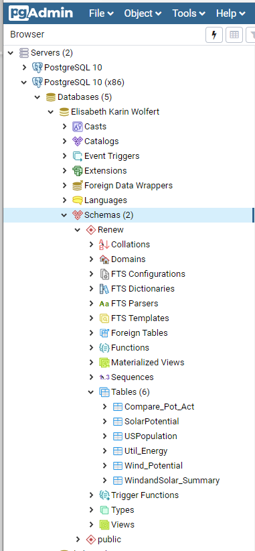
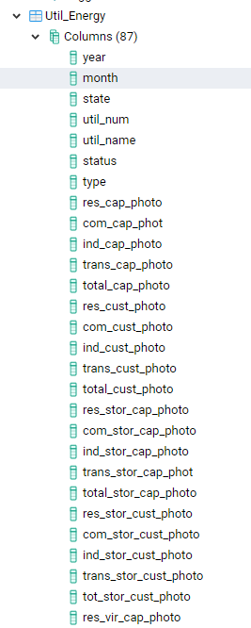
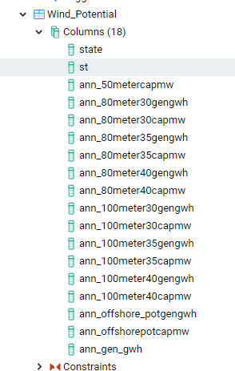
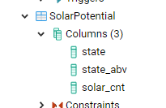
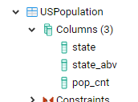
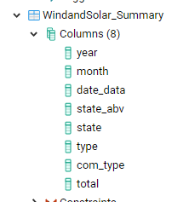
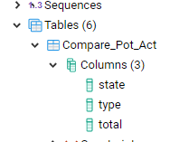
Postgres Data base tables created used for my project. Util Energy is the primary data source. Wind and Solar Potential and US Population by state. Then the merged the data into tables to be used in reporting.

Slide 14

Tableau Report Section
Renewable Energy Story

Slide 15
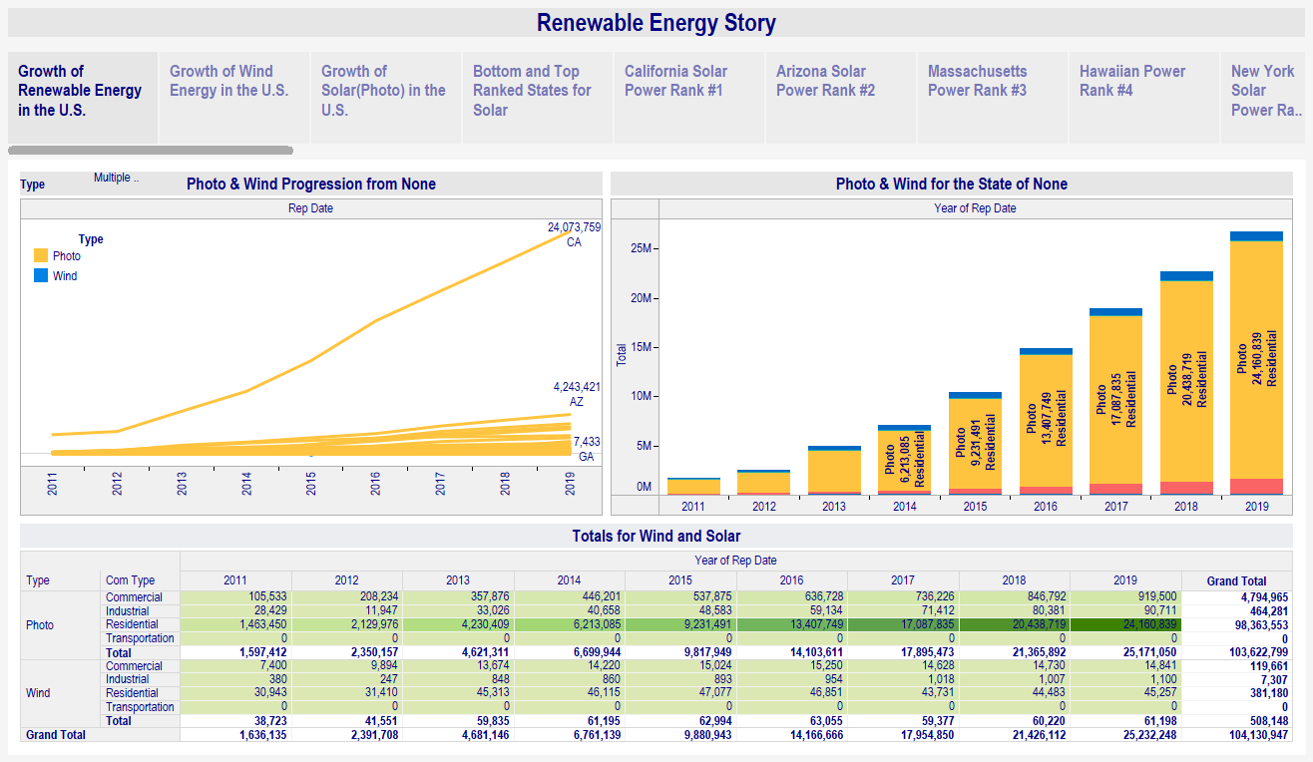
Renewable energy in the united states is dominated by Solar energy. The chart below combines both wind and solar energy. California has exceeded every state in the use of renewable energy.

Slide 16
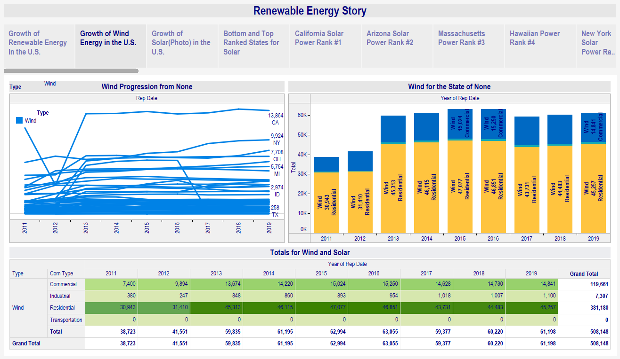
Like solar energy California is the leader in wind energy. The use of wind energy is used primarily in residential areas.

Slide 17
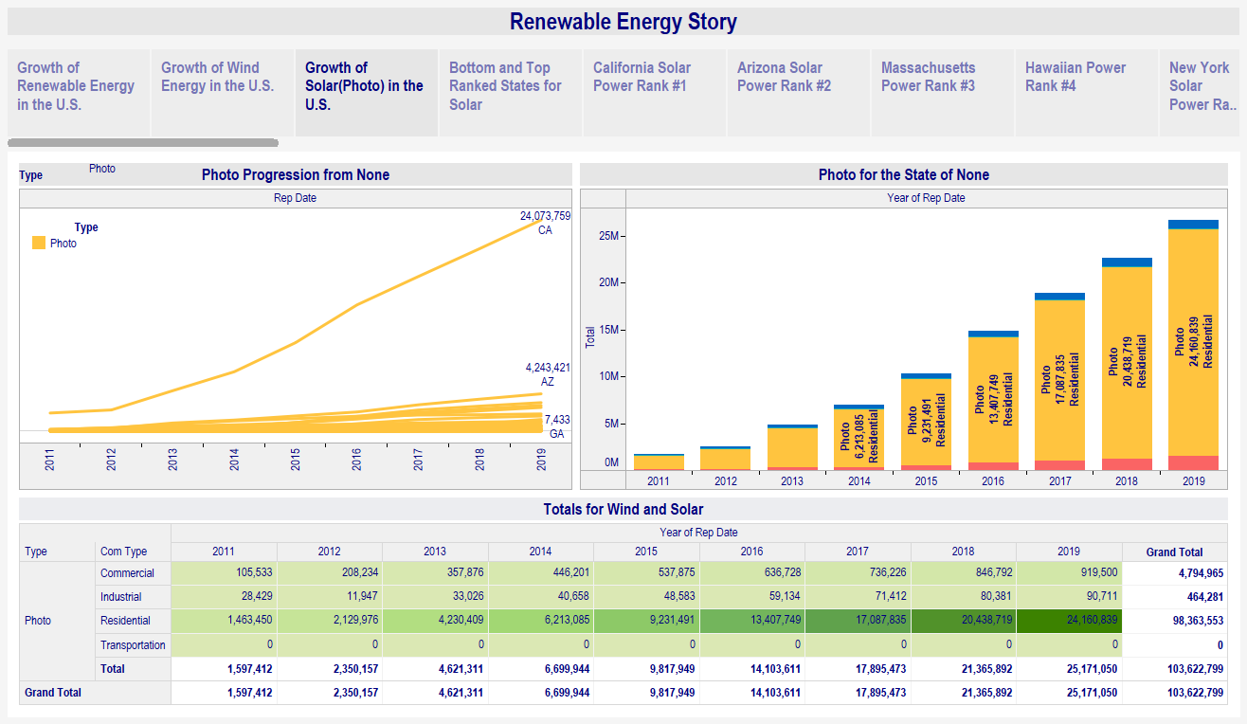
The chart below shows only solar or photovoltaic energy numbers. The use of solar especially in residential areas has grown steadily the last ten years.

Slide 18
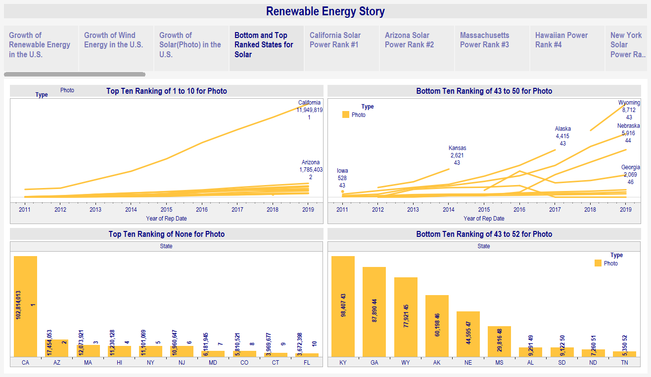
Ranking chart - This chart shows the states in the top ten rank of solar energy and the bottom ten ranking of solar energy. The use of solar energy in California far exceeds the nation.

Slide 19
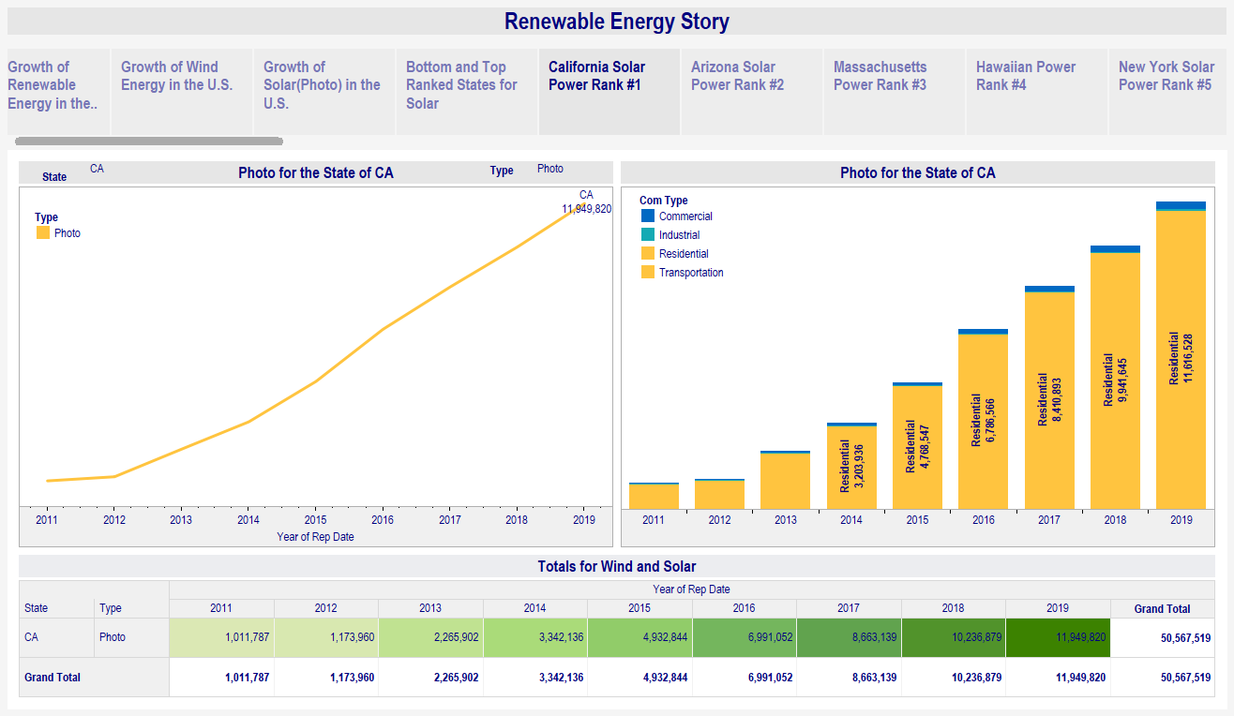
Rank #1 chart for solar is California. California had a goal to be at 30 percent renewable energy by 2030 which was met ten years early.

Slide 20
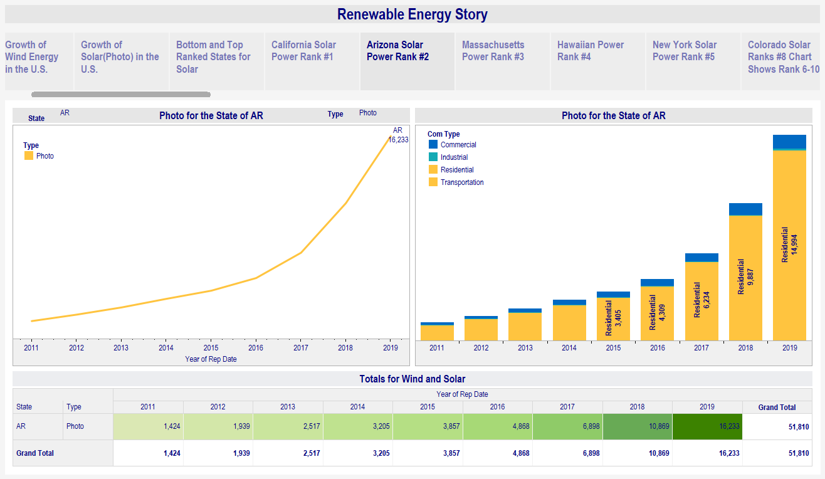
Ranked #2 - Arizona with a high growth in solar in the last two years.

Slide 21
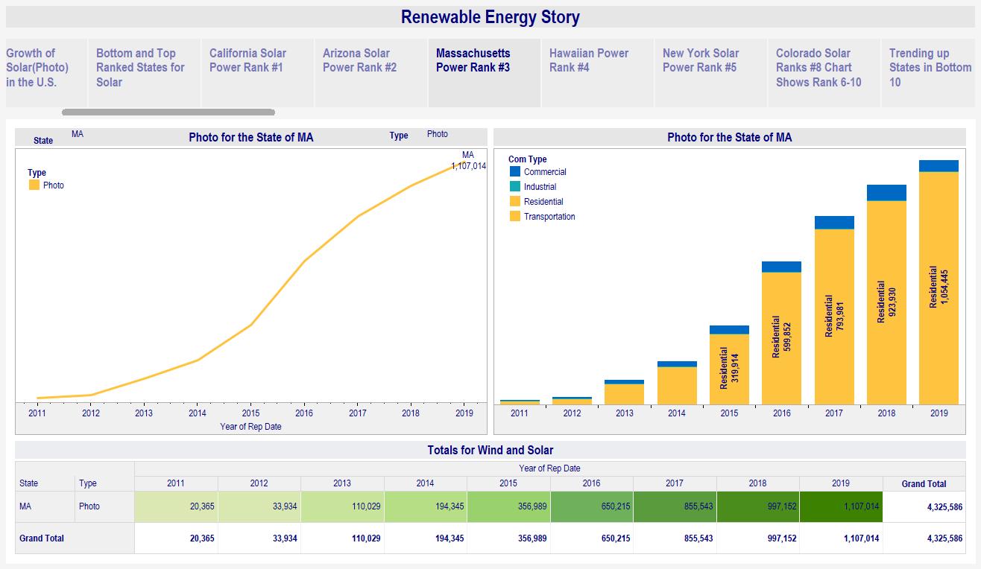
Rank #3 Massachusetts showing a steady increase in solar energy in the last four years.

Slide 22
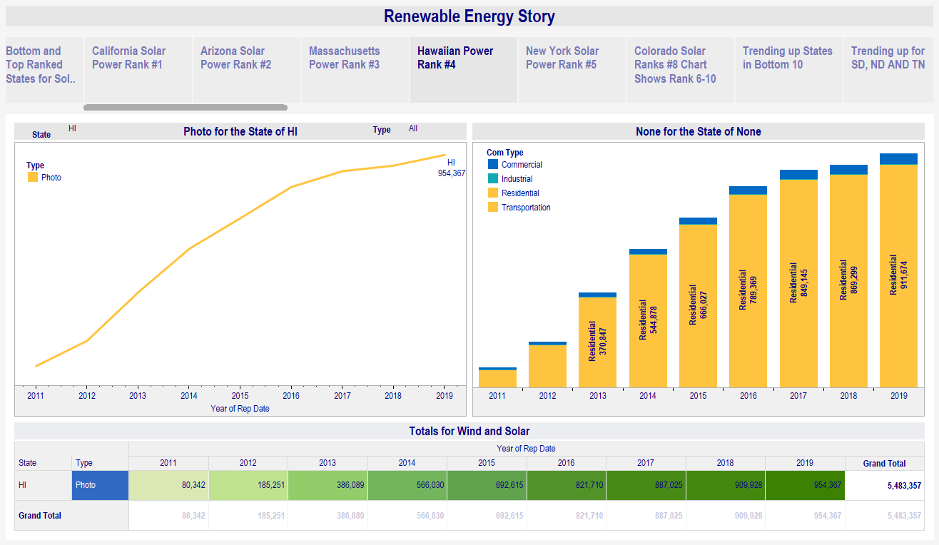
Rank #4 is Hawaii with stead increases in solar power since 2011. Hawaii is a state the cares strongly about the environment.

Slide 23
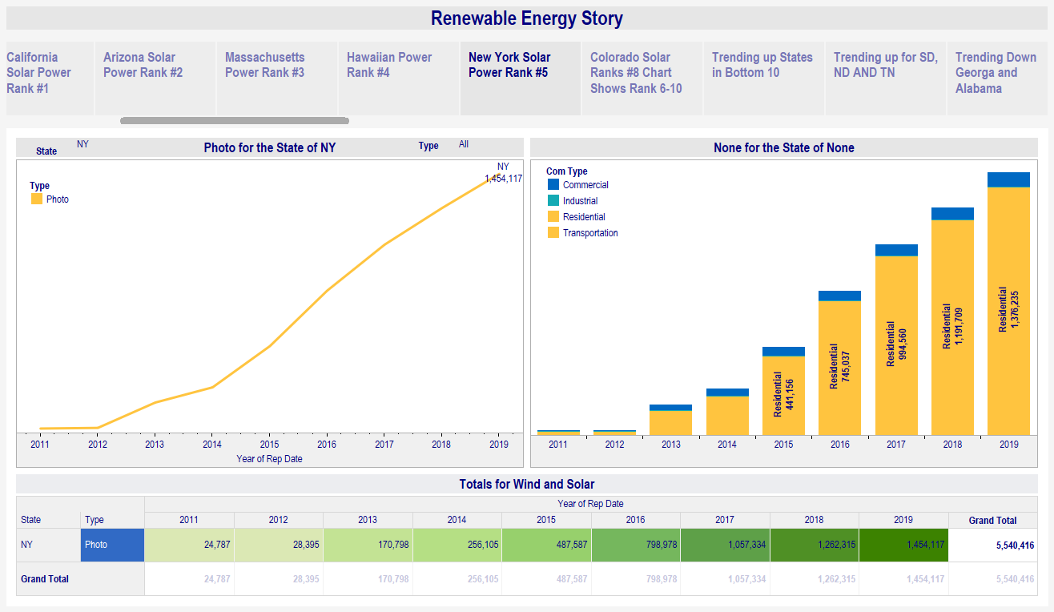
Ranked #5 is New York with a growing renewable energy market.

Slide 24
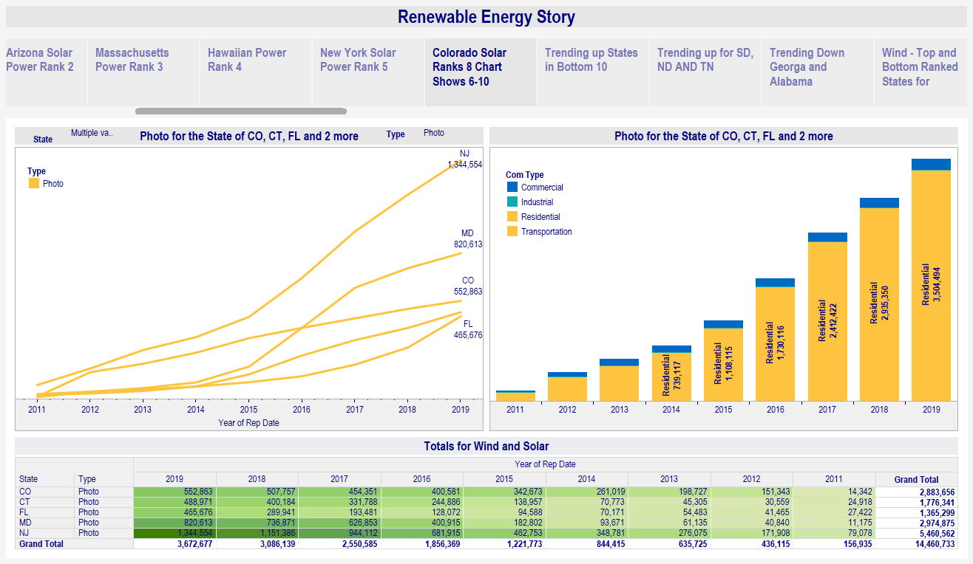
The next ranked states are New Jersey #6, Maryland #7, Sunny Colorado #8 and #9 Connecticut and # 10 Florida.

Slide 25
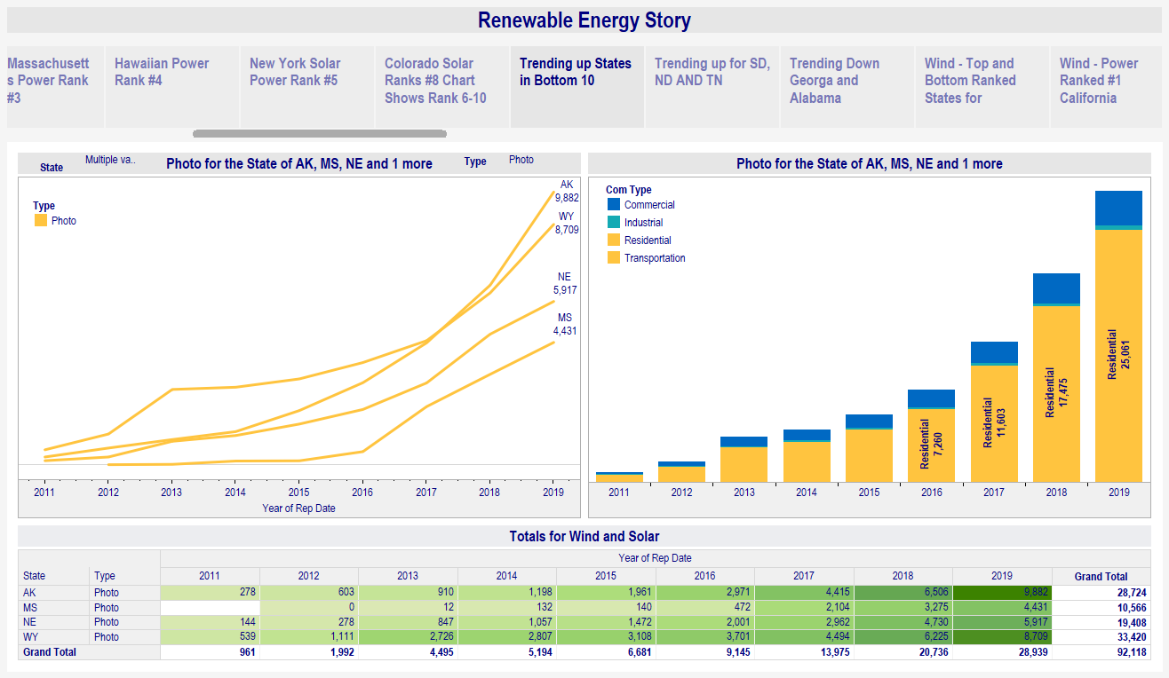
States ranking at the bottom are Alaska, Wyoming, Nevada and Mississippi. These states are trending up in the last couple years.

Slide 26
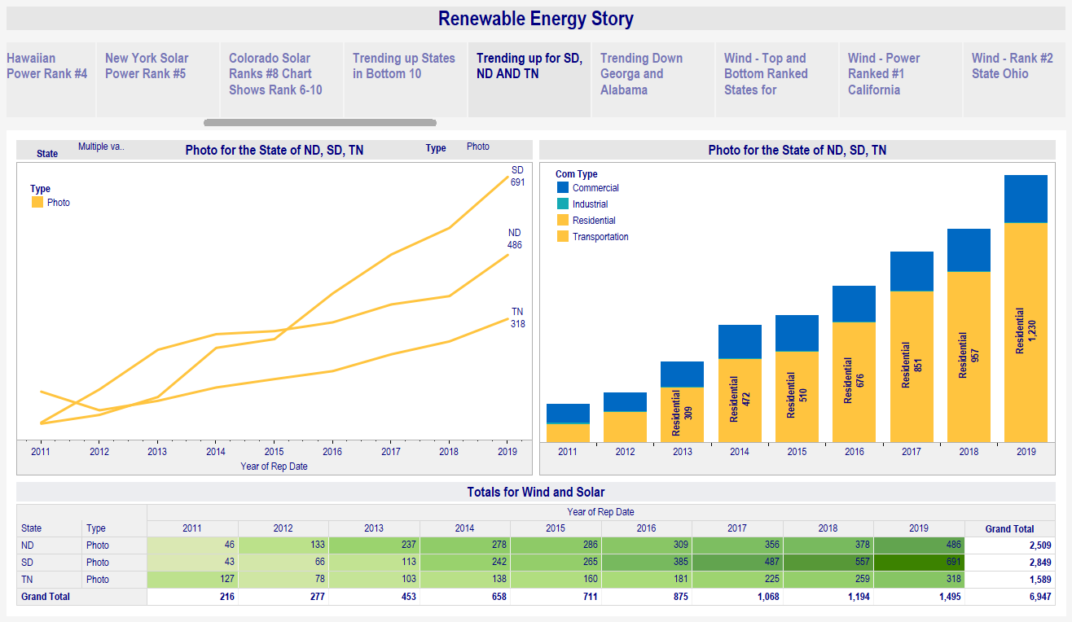
While at the very bottom North Dakota, South Dakota and Tennessee trending up, North Dakota has the highest potential for solar energy in the nation.

Slide 27
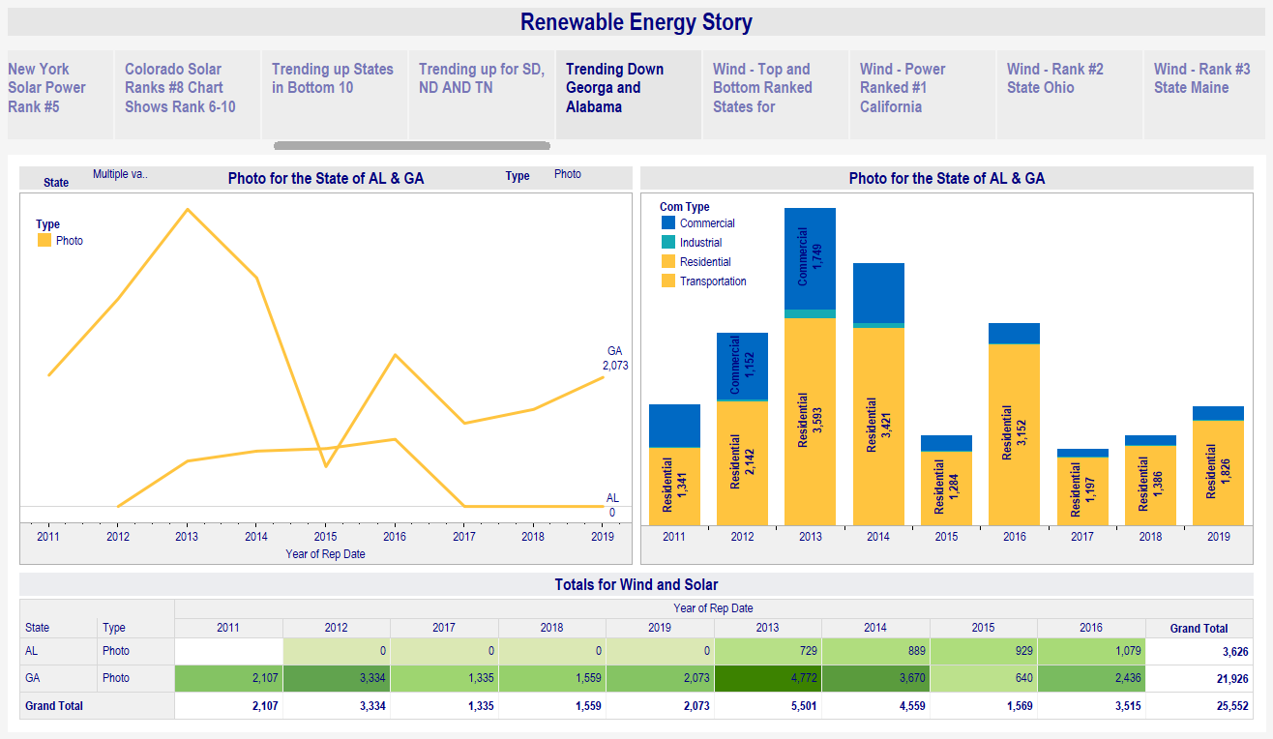
Georgia and Alabama are trending down for solar energy usage.

Slide 28
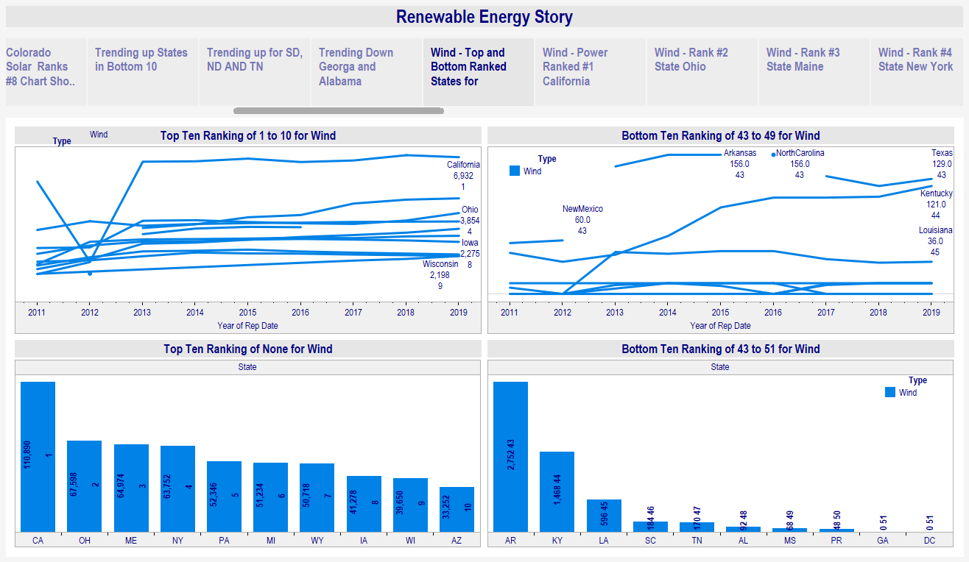
Again ranked #1 California leads the nation for wind energy usage.

Slide 29
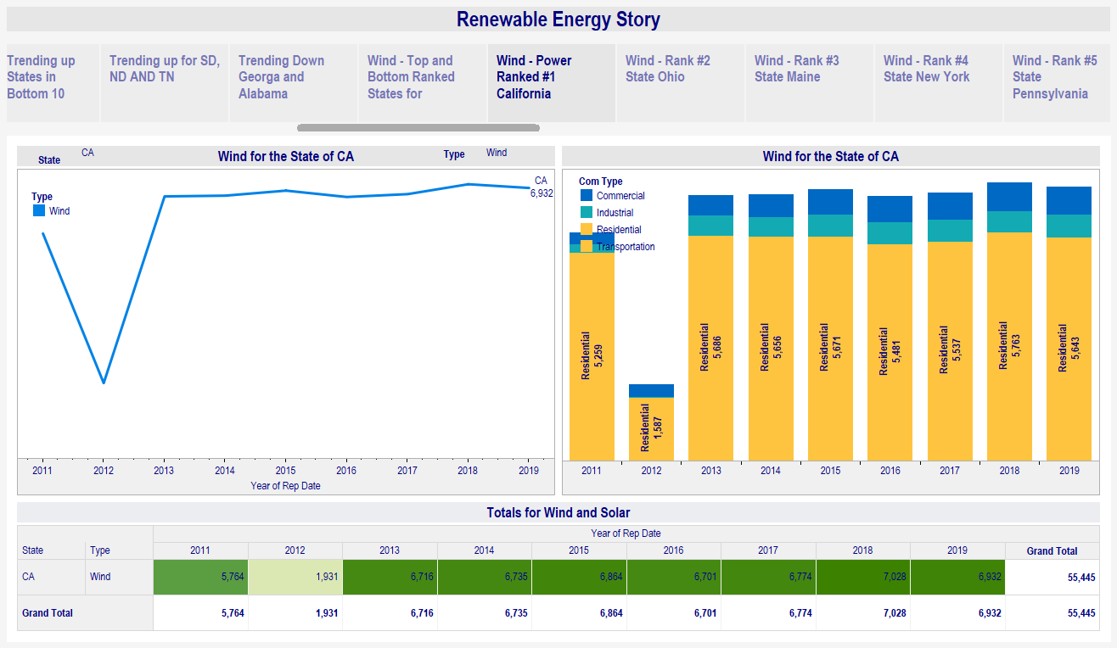
California wind energy primarily used for residential.

Slide 30
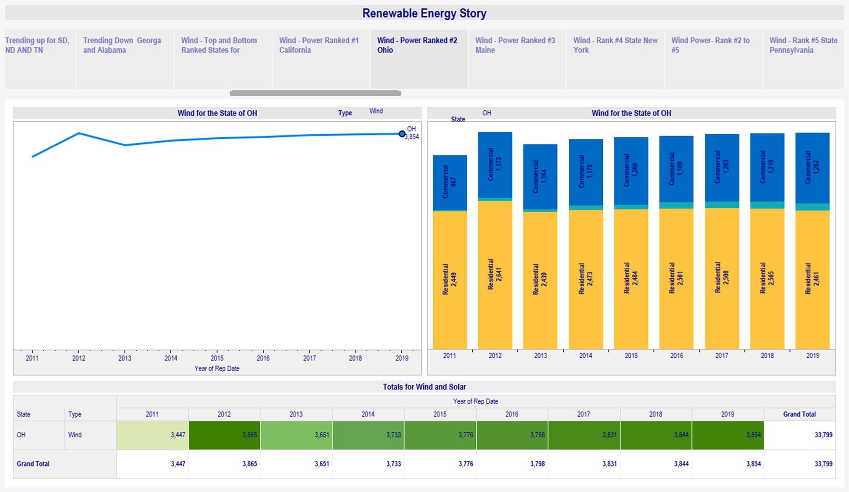

Slide 31
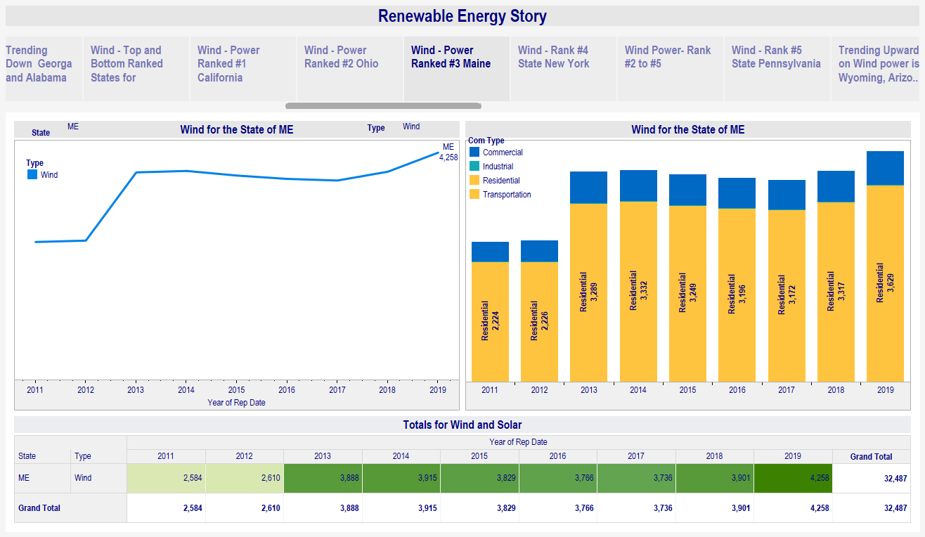

Slide 32
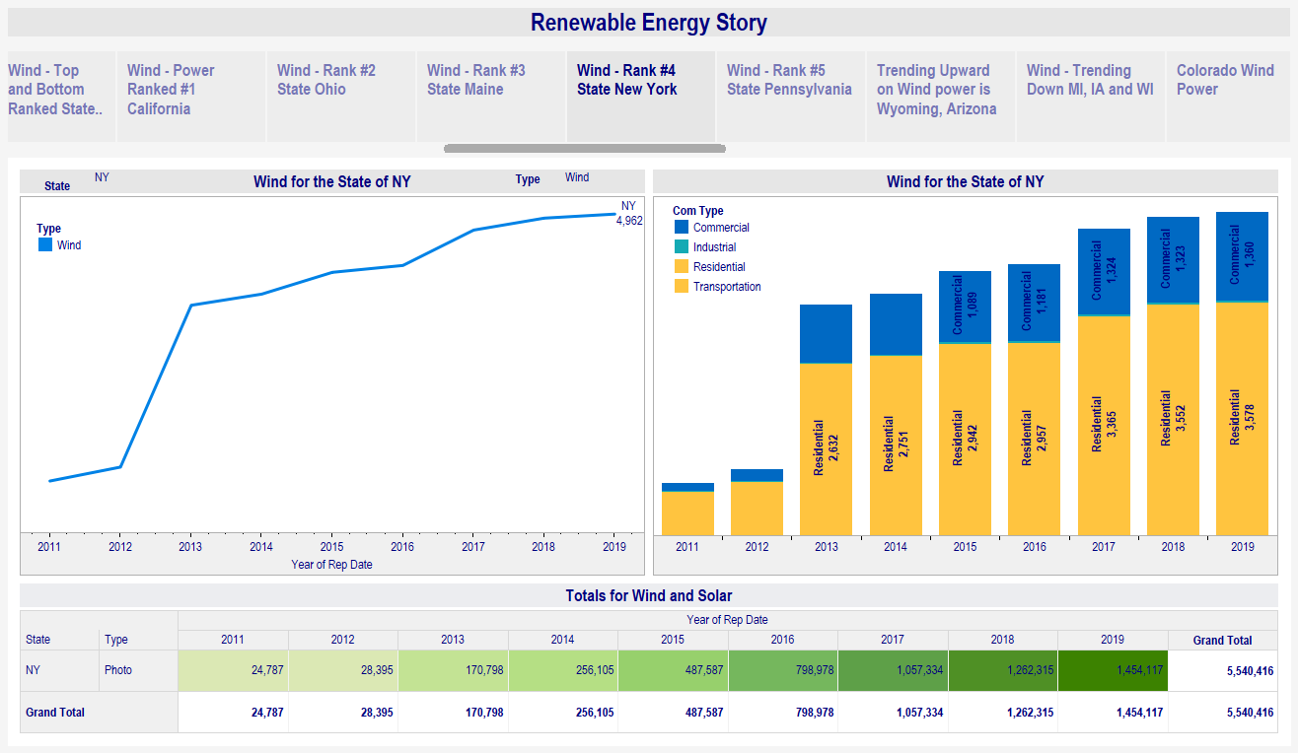
New York ranked #4 again is ranked in the top 5 for wind energy.

Slide 33
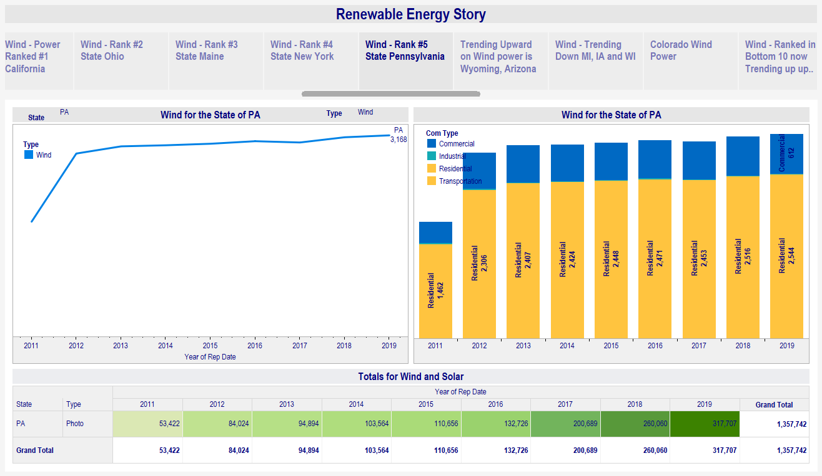
Ranked #5 is Pennsylvania for wind energy with primarily residential and commercial use.

Slide 34
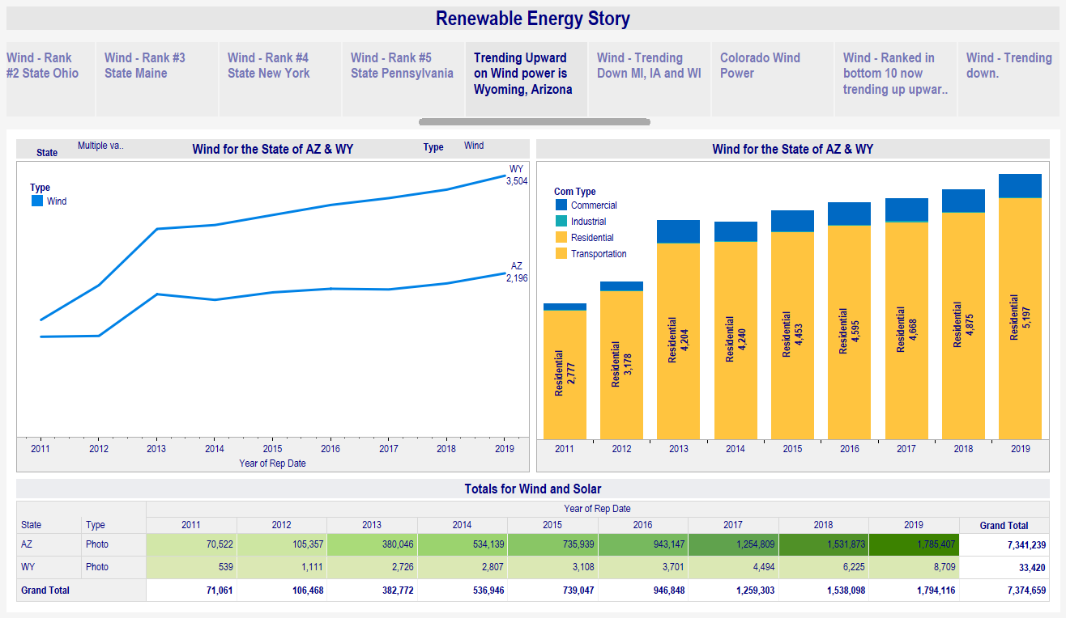
Wyoming ranked at #7 and Arizona # 10 for wind energy are trending up.

Slide 35
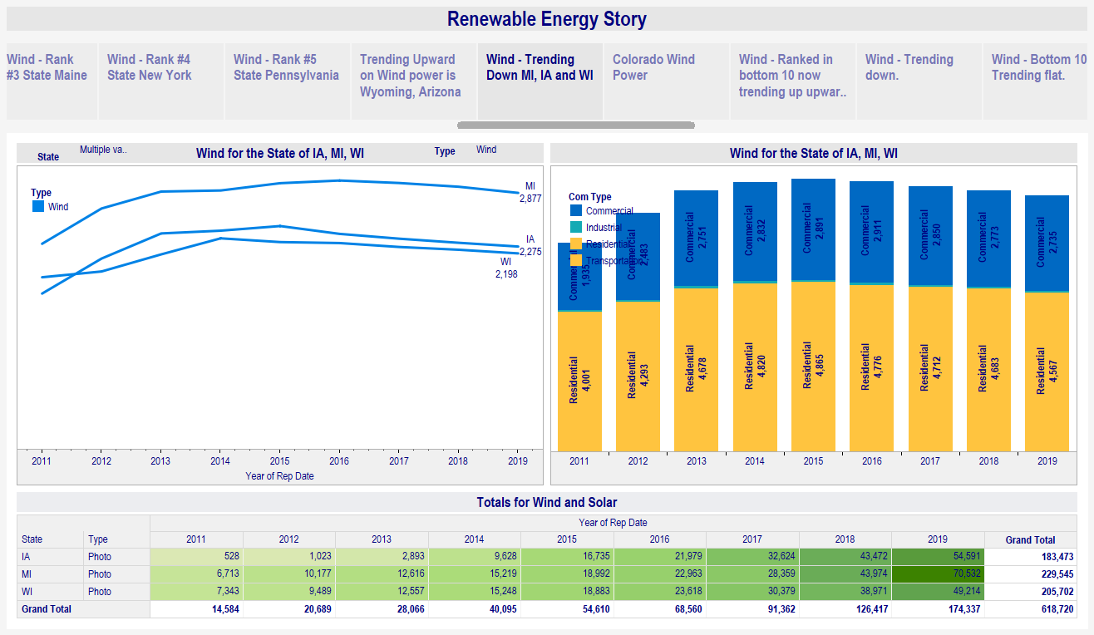
While ranked in the top ten Michigan #6, Iowa #8 and Wisconsin #9 are trending down.

Slide 36
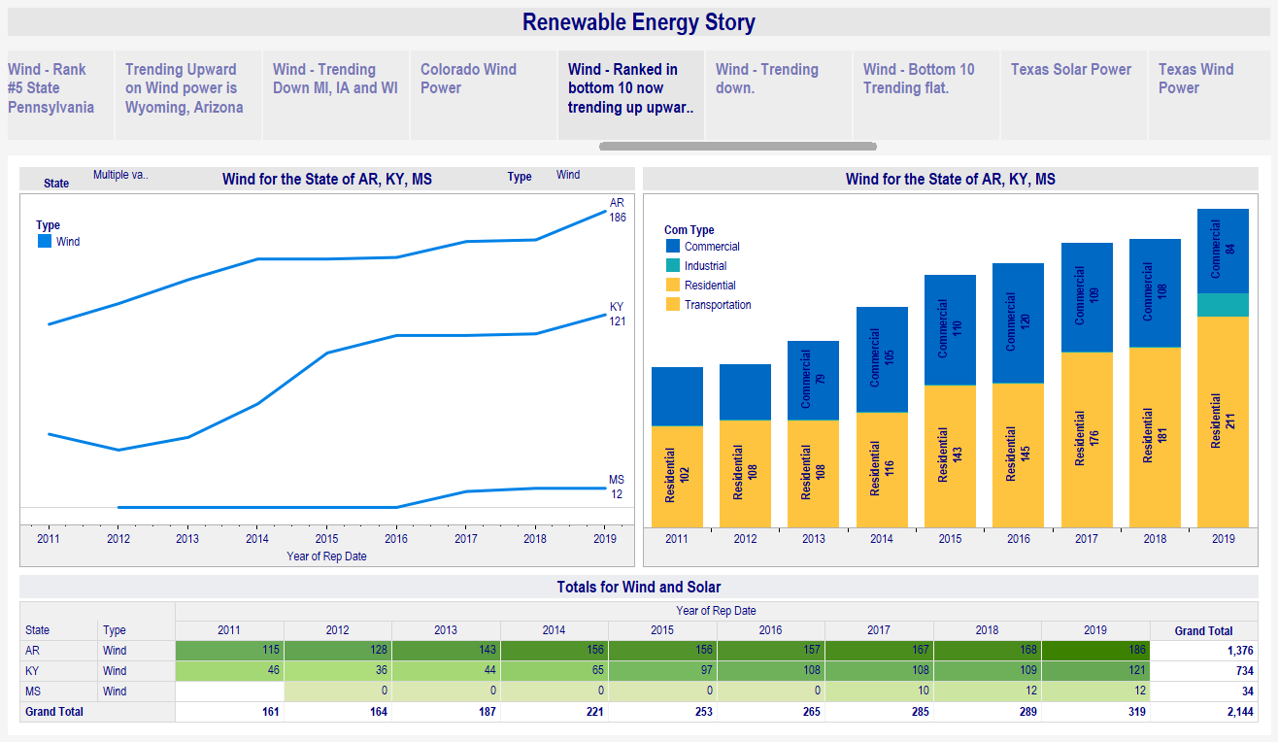
While in the bottom ten Arkansas, Kentucky and Mississippi are trending up.

Slide 37
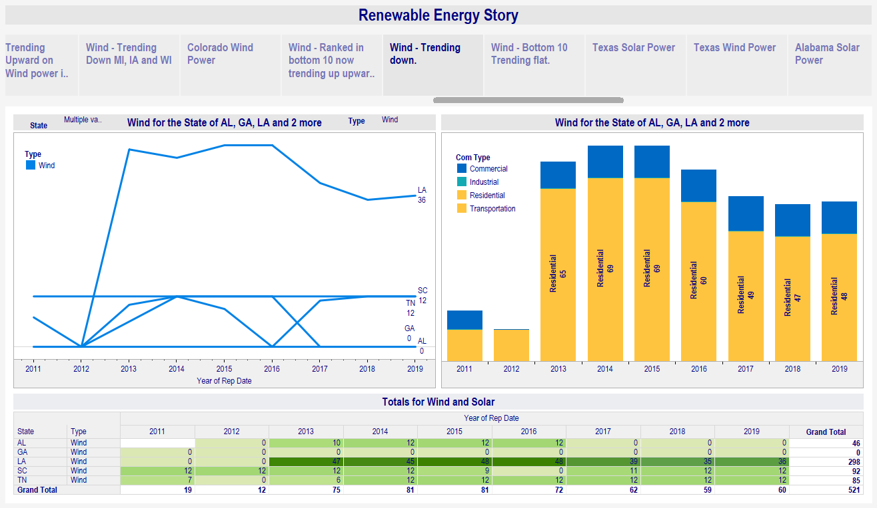
In the bottom ten trending down are Louisiana, Georgia, and Alabama. South Carolina and Tennessee are flattening out.

Slide 38
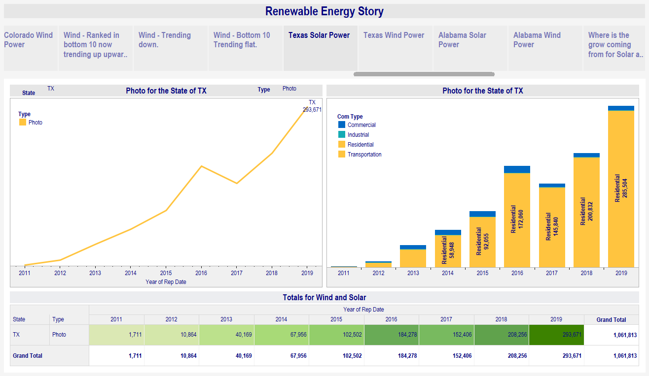
Based on the recent problems with the Texas power grid you can see the renewable solar is increasing in Texas primarily in residential.

Slide 39
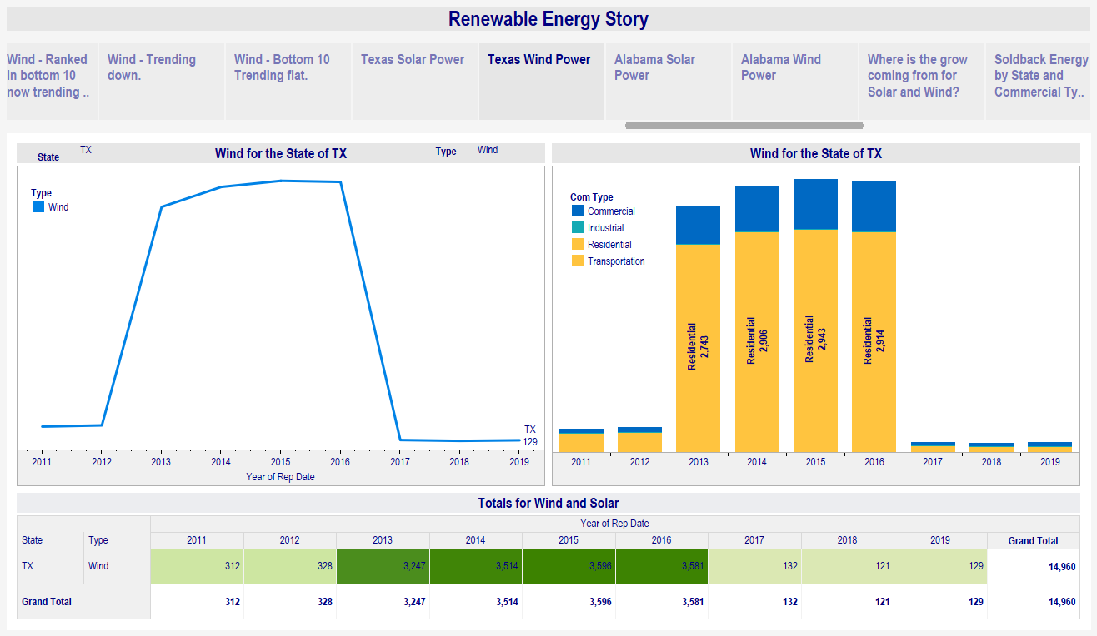
In Texas you can see that wind energy has dropped drastically since 2016. Texas has the highest potential for wind energy in the United States. If the wind energy increased at the rate prior to 2016 what would have been the results during the extreme weather event last month.

Slide 40
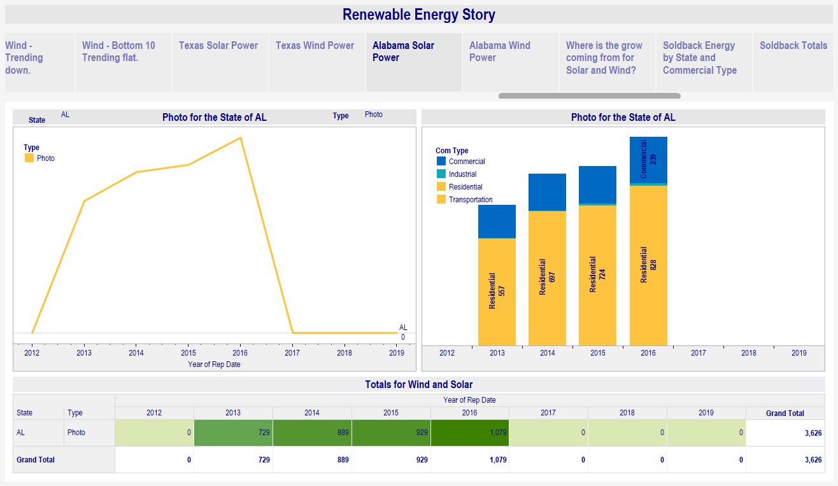
There was a similar drop in Alabama since 2016 shown below.

Slide 41
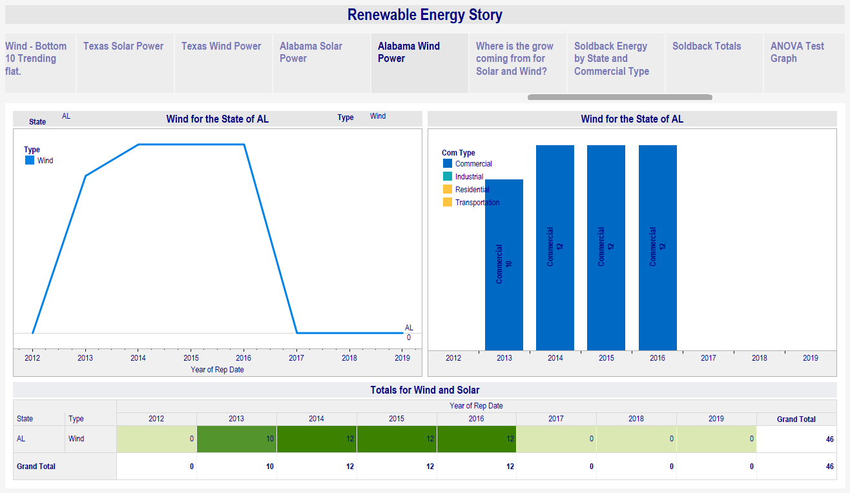
Similar drop for Wind in Alabama since 2016 for Wind.

Slide 42
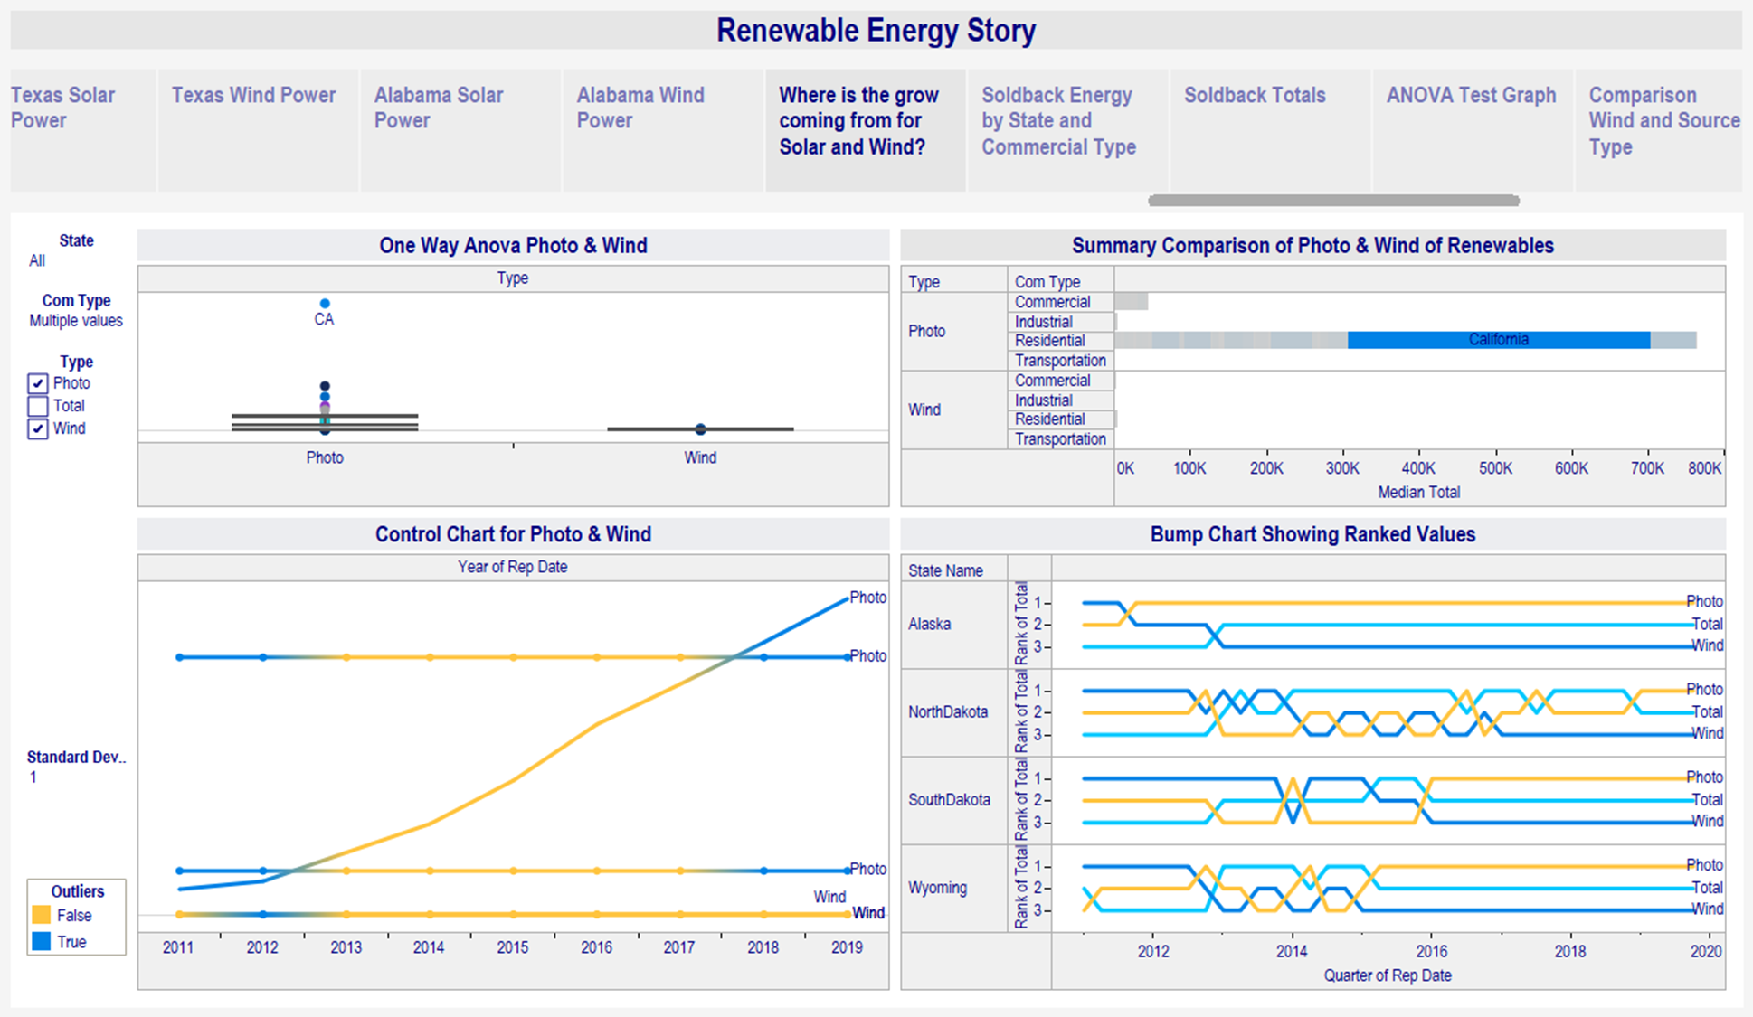
When looking at renewable energy Solar from residential sources towers over other types of energy.

Slide 43
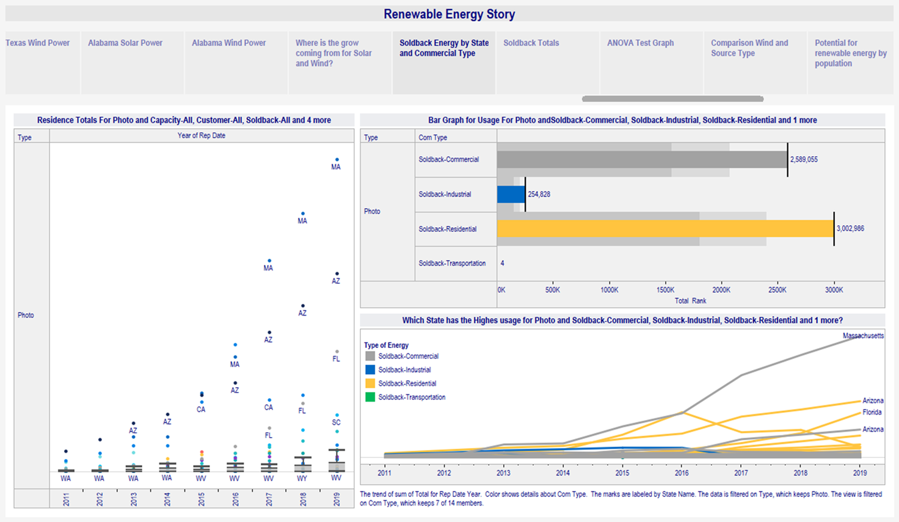

Slide 44
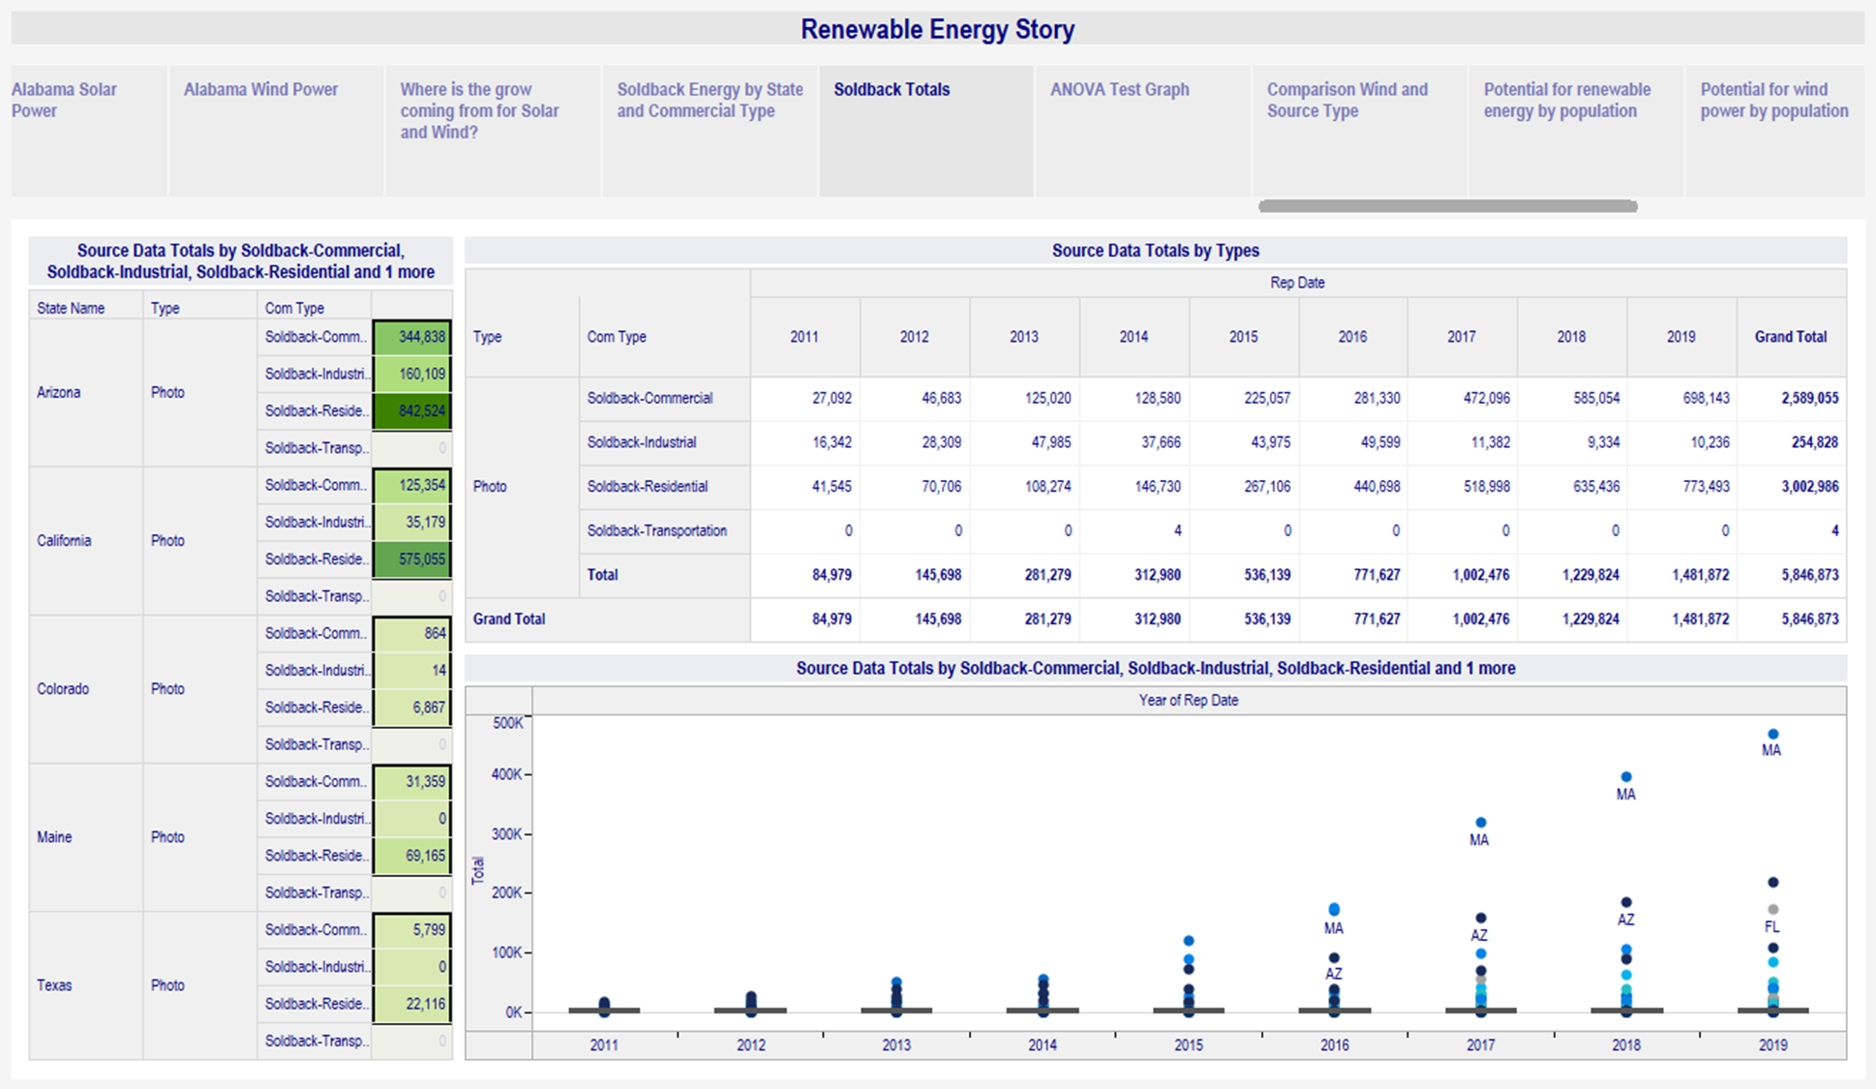

Slide 45
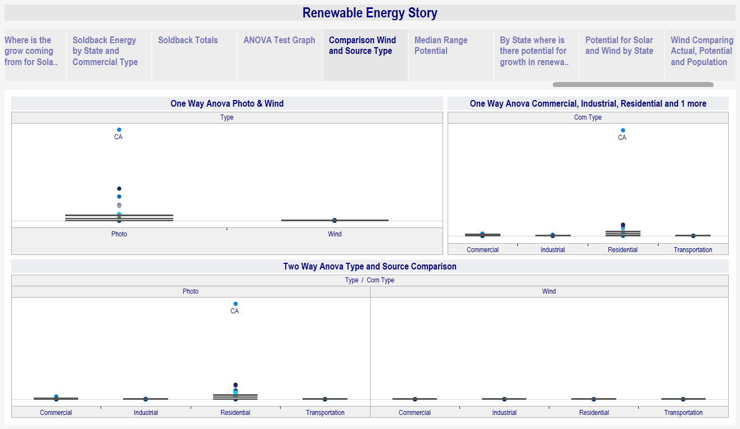
Viewing comparisons in the box plot shows that Solar energy is advancing rapidly primarily in the residential market.

Slide 46
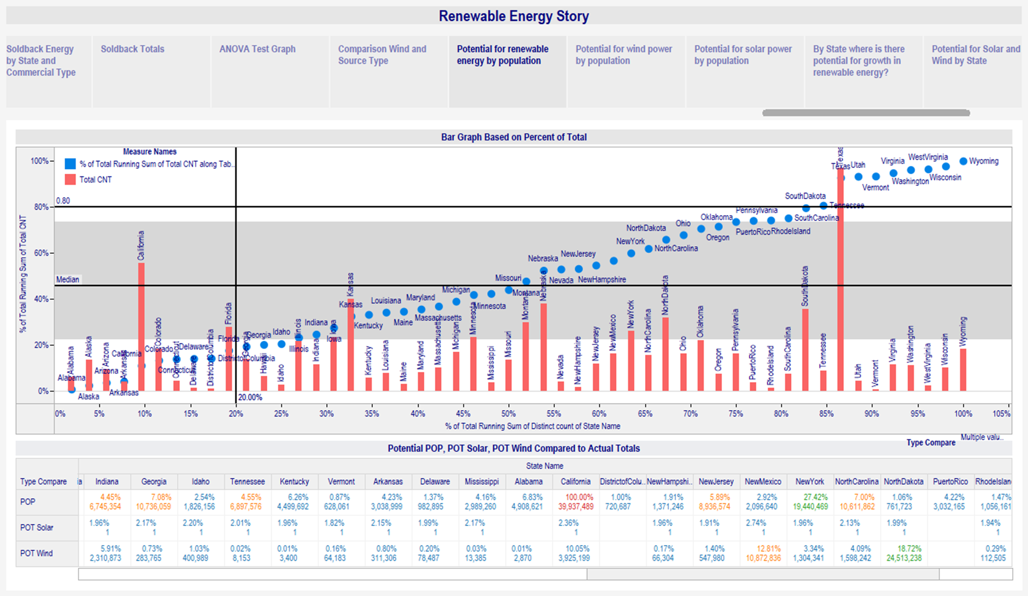
Potential for Renewable Energy in The United States

Slide 47
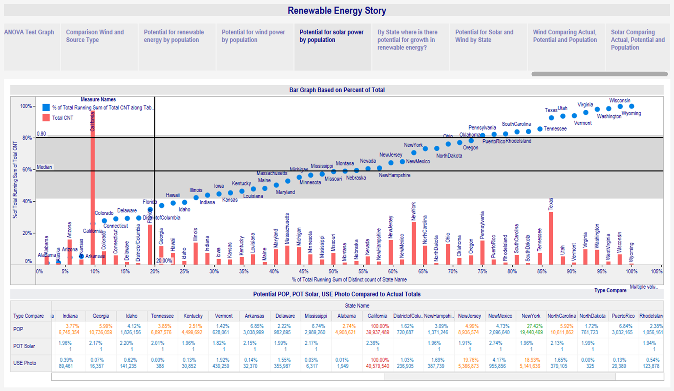

Slide 48
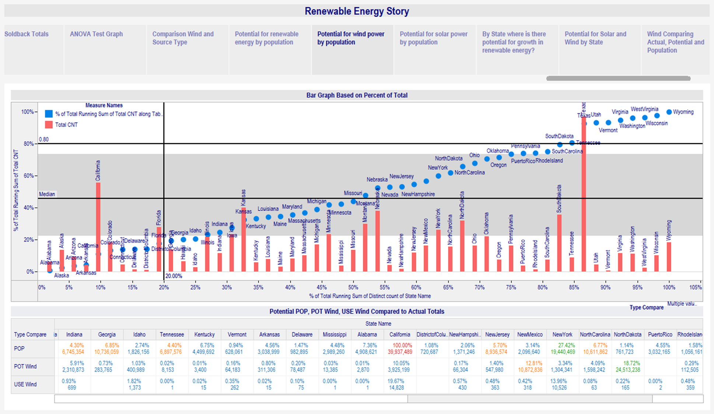
Potential for Wind power compared to Population

Slide 49
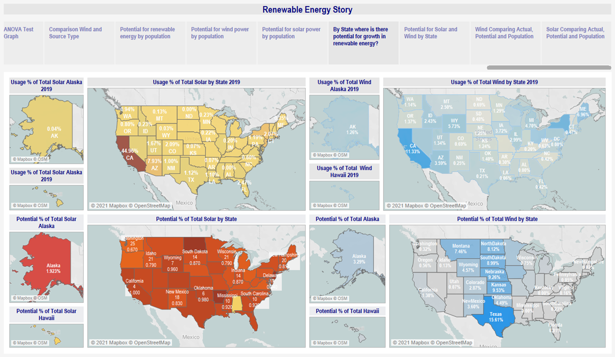
The maps show the comparison of utilization to potential for solar and wind energy. California exceeds the nation in both areas. Solar energy potential is highest in North Dakota and wind energy highest in Texas.

Slide 50
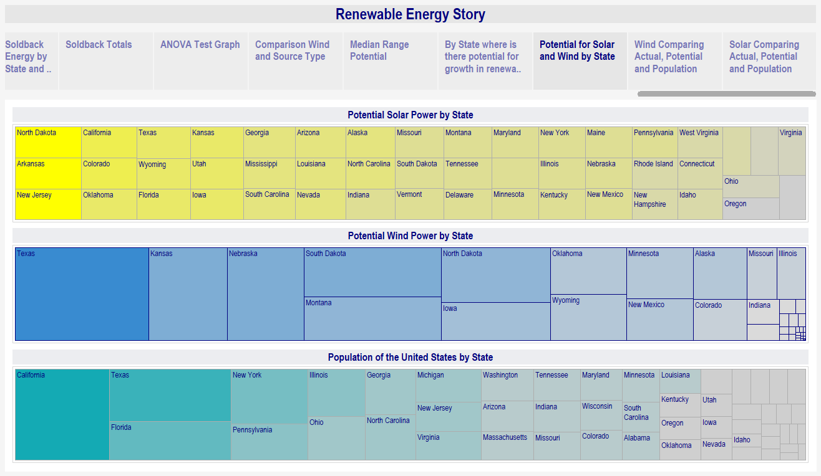
We can see below again the highest potential for solar is North Dakota and wind Texas. The states that would benefit the most with high populations are California Texas, Florida and New York.

Slide 51
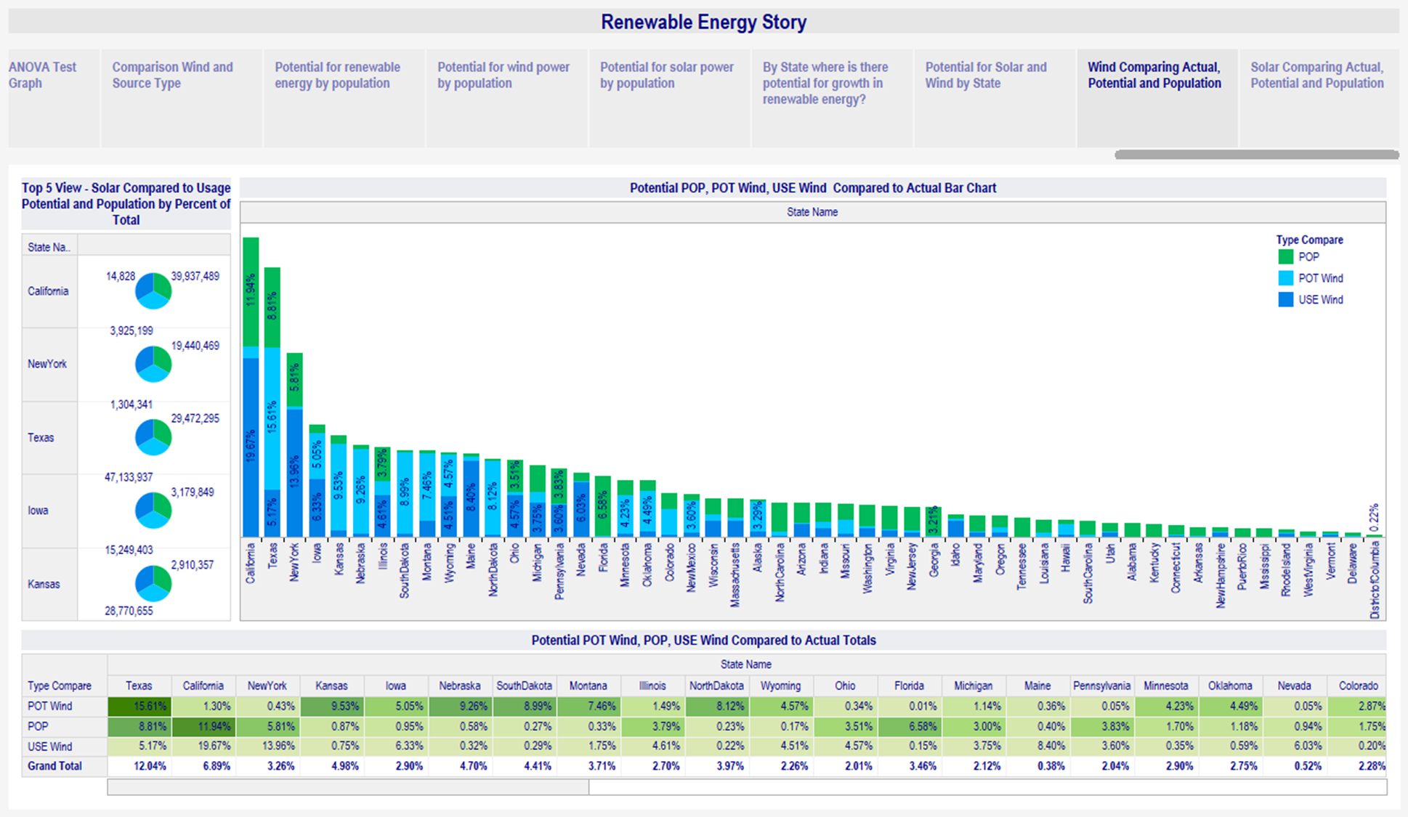

Slide 52
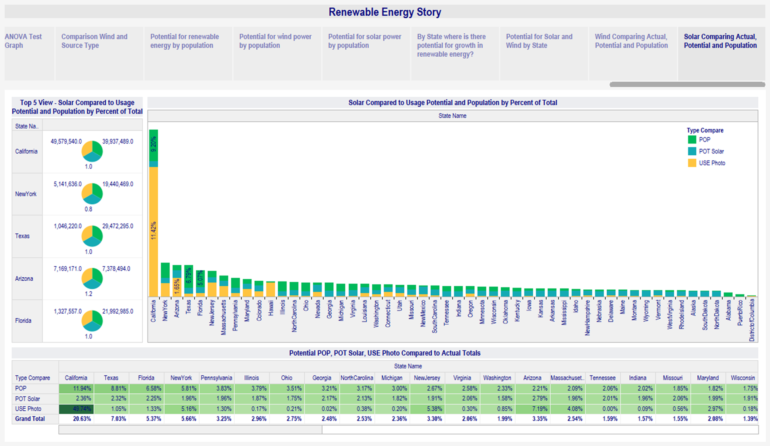
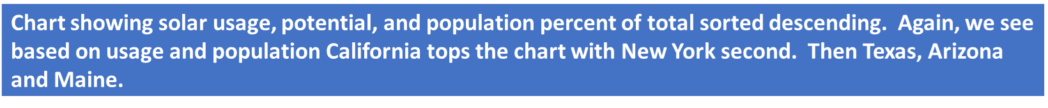

Slide 53
Python Spacy Package Word Count
Greenpeace Text data

Slide 54
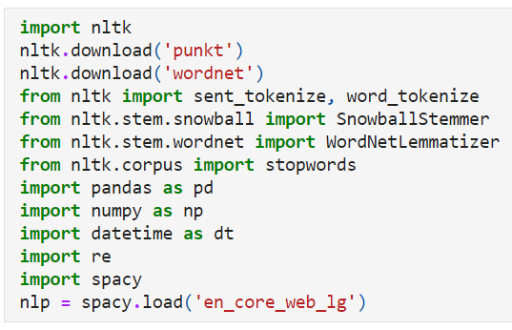

Load required packages for script using python spacy package
Read in text file into Python

Slide 55


Split words and sentences
Result of split words and sentences

Slide 56


Remove punctuation and created stemmed words from text.

Slide 57



Remove Stop Words
Remove Stop Words: (And, to, are, etc.)

Slide 58

Create data frame and count word list

Slide 59

Import Matplotlib package and create data frame for visualization

Slide 60

Chart with common words sorting from the highest count to the lowest count

Slide 61

Create python data frame to show organizations

Slide 62

Word Chart by Organization

Slide 63

Top people mentioned in text data frame

Slide 64

Top People mentioned in text data set

Slide 65
Postgres Data base tables created used for my project.

Slide 66
R- Studio R markdown script
One-Way and Two-way ANOVA

Slide 67


Libraries and data set used in R studio Markdown script

Slide 68

Created boxplot graph which shows photo(solar) has a higher significance

Slide 69

Data for boxplot Com type is Commercial Industrial Residential and Transportation

Slide 70

Comparison of Solar Type Wind or Solar and Com Type: Commercial, Residential, Industrial or Transportation

Slide 71


Scatter plot for Total and Type of Wind or Photo(Solar) energy. scatter.smooth(x=SolarWind$Total, y=SolarWind$Type, col=c("Green","Red"), main="Total ~ Type",ylab = "Type",xlab= "Total") # scatterplot
Smooth Scatter plot for Total and Com Type including Residential, Commercial or Industrial energy sources. scatter.smooth(x=SolarWind$Total, y=SolarWind$Com_Type, col=c("Green","Red"), main="Total ~ Type",ylab = "Source Type",xlab= "Total") # scatterplot

Slide 72


Plot the means for energy type of Solar or Wind showing Photo(Solar) to be significant. Plot the means comparing Com Type or energy source showing that Residential is significant.

Slide 73

Ran a one-way ANOVA test with the p value less than 0.05 with (P > 2.89e-14) giving the level of significance. Now that the data has been evaluated, we run the one-way ANOVA test and see that the P value shows a 95 percent significance with the p value (p<=0.05) so we can not accept the null hypothesis. The null hypothesis is rejected, and we can see that there is a significant difference between the two types of Wind and Photo(Solar) energy types.
According to the output of the test for energy type being (F(1,627)=60.61,p=2.89e-14) we see a high level of significance between energy types.

Slide 74

One Way ANOVA: Commercial, Residential or Industrial
Ran a one-way ANOVA test with the p value less than 0.05 with (P > <2e-16) giving the level of significance. Now that the data has been evaluated, we run the one-way ANOVA test and see that the P value shows a 95 percent significance with the p value (p<=0.05) so we can not accept the null hypothesis. The null hypothesis is rejected, and we can see that there is a significant difference between the two types of Wind and Photo(Solar) energy types.
#According to the output of the test for energy type being (F(2,626)=67.29,p=<2e-16) we see a high level of significance between energy types.

Slide 75


Residuals for Solar and Wind Totals

Slide 76


Wind and Solar Totals - Cook’s distance

Slide 77


Residuals for Wind and Solar for Commercial Type

Slide 78


Residuals for Wind and Solar Data Totals by Commercial Type

Slide 79

Pairwise T Test on Type Wind and Solar

Slide 80

Pairwise T-Test for Wind and Solar Totals by Commercial Type

Slide 81


Levene Test for Homogeneity of Variance on Solar and Wind Totals
Levene Test for Homogeneity of Variance on Solar and Wind Totals by Commercial Type

Slide 82

One Way test comparing Solar and Wind data Totals
One-Way test comparing Wind and Solar Total by Commercial Type

Slide 83

The Interaction Plot shows that Photo(Solar) has more significance in the data

Slide 84


Interaction Plot on the Wind and Solar Total based on Commercial Type showing that Residential data has more significance in the data set.

Slide 85

H0: There will be no difference between the mean types for Wind or Photo(Solar) energy usage or source energy type (com type) H0: There is no difference between mean types for Wind or Photo (Solar) utilization and produced energy H0: There is not affect on energy production based on energy type wind or solar or the source of the energy commercial, residential, industrial, or transportation. H1: There will be a difference between the mean types for Wind or Photo(Solar) energy usage and source type (com type). H1: There will be a difference between the mean types for Residential, Commercial and Industrial usage. H1: There will be a difference in the amount of energy produced for wind or solar and the source type of that energy. Source types include residential, commercial, industrial or transportation. H1: There is an interaction between energy type of wind or solar and energy source residential, commercial, industrial or transportation.
Now we run a two-way ANOVA test to see if there is any difference in significance between the types of energy sources for Wind and Photo(Solar) energy or the source of that energy of Residential, Industrial of Commercial.

Slide 86


Residuals for Wind and Solar data by totals by Type and Commercial Type
Residuals for Wind and Solar Data by totals by Type and Commercial Type

Slide 87



Slide 88


Slide 89

Plot the residuals for the two-way ANOVA test

Slide 90

Run the Tukey Two-Way test on ANOVA data for Solar and Wind data by Total – Solar or Wind Type, Commercial Type – Commercial, Residential, Industrial or Transportation

Slide 91


Tukey test for Wind and Solar Data by Type or Commercial Type

Slide 92


Slide 93


Slide 94


Linear Regression Model for Solar Wind Data Total by Type and Commercial Type
Test Results:

Slide 95

Coefficients for Type Wind by Commercial Type

Slide 96

Results of Coefficients Intercepts with a F-statistic: 213.1 on 5 and 26045 Df, P value < 2.2e-16

Slide 97


Plot the residuals for the linear regression model. The residuals vs. fitted and the Normal Q-Q shows a standard S curve for Wind and Solar Total by Type and Commercial Type

Slide 98


Residuals for the Wind and Solar data totals by Type and Commercial Type

Slide 99

Conclusion – Wind Solar – Residential Commercial Industrial or Transportation Data
California has become the leader in renewable energy in the country taking on the challenge to convert to renewable energy 100 percent by the year 2045. Homeowners have taken the investment in solar energy in their homes to help in this initiative. This is shown in the data showing Solar energy in the residential area shows the greatest significance in the data. Following California in solar is

Slide 100
References
My Account - Windsource® (xcelenergy.com)https://www.cnbc.com/2019/10/31/us-wind-energy-capacity-now-over-100-gigawatts-says-new-report.html
http://www.bionomicfuel.com/benefits-of-windmill-energy/https://www.cnbc.com/2020/10/14/facebook-to-use-ai-in-bid-to-improve-renewable-energy-storage.htmlYears of Living
Dangerously: Climate Change Deniers and Kansas Wind Energy –
Greenpeace USAYears of Living Dangerously Season 1: Episode 6 Clip - Droughts – YouTube
solar energy pictures photos – Bing
10 Advantages of Solar Energy, Benefits of Solar Energy (linquip.com)
New Colorado laws could help shift state away from carbon emissions - Denver Business Journal
renewable energy - Bing images
Electricity Net Metering by Utility in US | Colorado Information Marketplace | data.colorado.gov
1543436651044.jpg (500×308) (azureedge.net)
Electricity Net Metering by Utility in US | Colorado Information Marketplace | data.colorado.gov
Wind generation potential in the United States - Wikipedia
Sun Potential
Comparison of Solar Power Potential by State (ne.gov)
Renewable Electricity Mandates and Goals - IER (instituteforenergyresearch.org)

Slide 101


